Slide 1

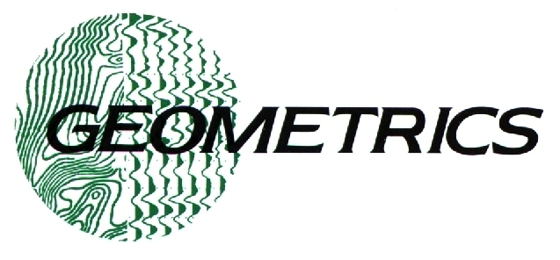


Fundamentals of Seismic Refraction Theory, Acquisition, and Interpretation
Craig Lippus
Manager, Seismic Products
Geometrics, Inc.
December 3, 2007

Slide 2
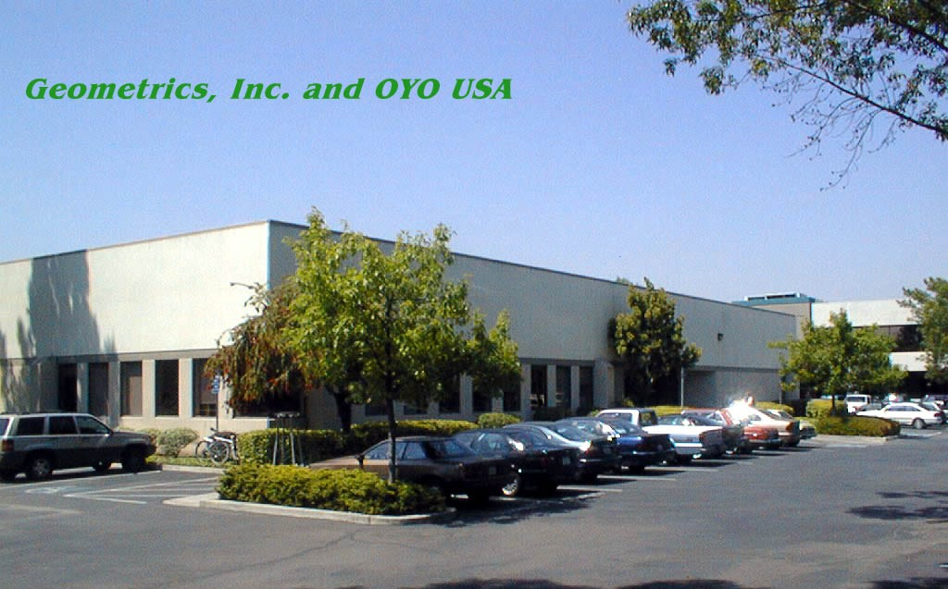
Geometrics, Inc.
Owned by Oyo Corporation, Japan
In business since 1969
Seismographs, magnetometers, EM systems
Land, airborne, and marine
80 employees

Slide 3
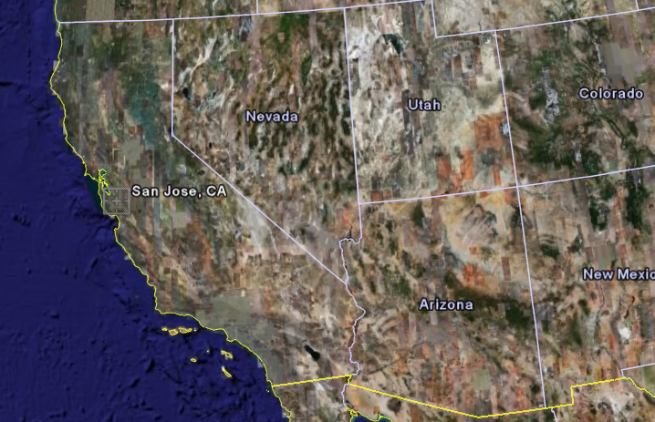
Located in San Jose, California

Slide 4
Fundamentals of Seismic Waves
What is a seismic wave?

Slide 5
Fundamentals of Seismic Waves
What is a seismic wave?
Transfer of energy by way of
particle motion.
Different types of seismic waves are characterized by their particle motion.

Slide 6
Three different types of seismic waves
Compressional (“p”) wave
Shear (“s”) wave
Surface (Love and Raleigh) wave
Only p and s waves (collectively referred to
as “body waves”) are of interest
in seismic refraction.

Slide 7
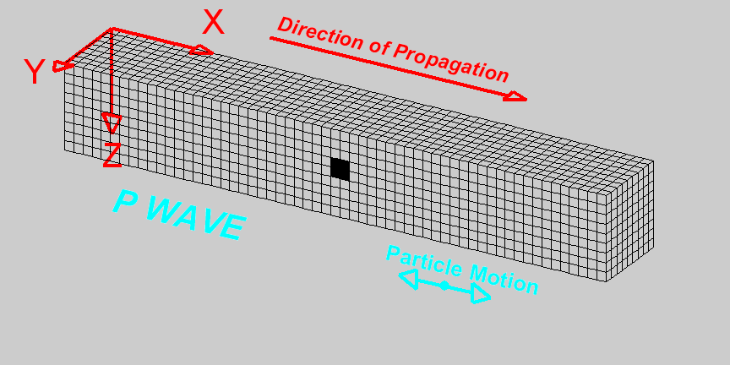
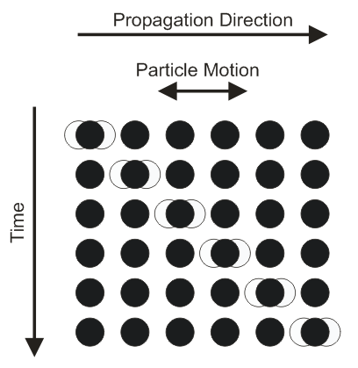
Compressional (“p”) Wave
Identical to sound wave – particle
motion is parallel to propagation
direction.
Animation courtesy Larry Braile, Purdue University

Slide 8
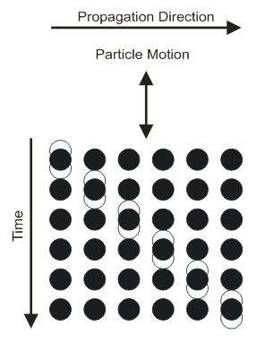
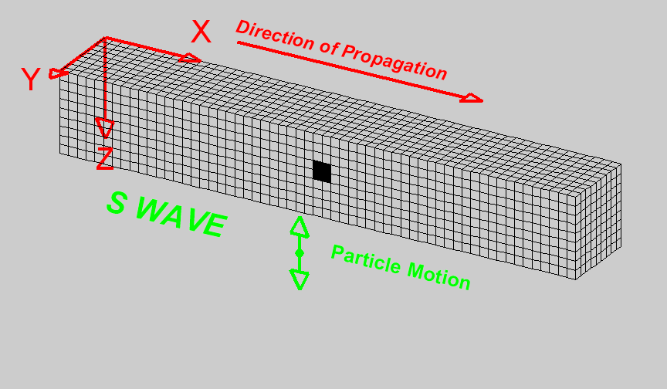
Shear (“s”) Wave
Particle motion is perpendicular
to propagation direction.
Animation courtesy Larry Braile, Purdue University

Slide 9
Velocity of Seismic Waves
Depends on density elastic moduli
where K = bulk modulus, μ = shear modulus, and ρ = density.

Slide 10
Velocity of Seismic Waves
Bulk modulus = resistance to compression = incompressibility
Shear modulus = resistance to shear = rigidity
The less compressible a material is, the greater its p-wave velocity, i.e., sound travels about four times faster in water than in air. The more resistant a material is to shear, the greater its shear wave velocity.

Slide 11
Q. What is the rigidity of water?

Slide 12
A. Water has no rigidity. Its shear strength is zero.
Q. What is the rigidity of water?

Slide 13
Q. How well does water carry shear waves?

Slide 14
A. It doesn’t.
Q. How well does water carry shear waves?

Slide 15
Fluids do not carry shear waves. This knowledge, combined with earthquake observations, is what lead to the discovery that the earth’s outer core is a liquid rather than a solid – “shear wave shadow”.

Slide 16
p-wave velocity vs. s-wave velocity
p-wave velocity must always be greater than s-wave velocity. Why?
K and μ are always positive numbers, so Vp is always greater than Vs.

Slide 17
Velocity – density paradox
Q. We know that in practice, velocity tends to be directly proportional to density. Yet density is in the denominator. How is that possible?

Slide 18
Velocity – density paradox
Q. We know that in practice, velocity tends to be directly proportional to density. Yet density is in the denominator. How is that possible?
A. Elastic moduli tend to increase with density also, and at a faster rate.

Slide 19
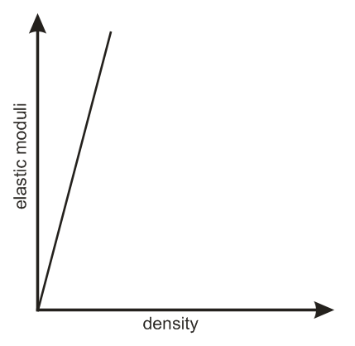
Velocity – density paradox
Note: Elastic moduli are important parameters for understanding rock properties and how they will behave under various conditions. They help engineers assess suitability for founding dams, bridges, and other critical structures such as hospitals and schools.
Measuring p- and s-wave velocities can help determine these properties indirectly and non-destructively.

Slide 20
Q. How do we use seismic waves to understand the subsurface?

Slide 21
Q. How do we use seismic waves to understand the subsurface?
Must first understand wave
behavior in layered media.

Slide 22
Q. What happens when a seismic wave encounters a velocity discontinuity?

Slide 23
Q. What happens when a seismic wave encounters a velocity discontinuity?
A. Some of the energy is reflected, some is refracted.
We are only interested in refracted energy!!

Slide 24
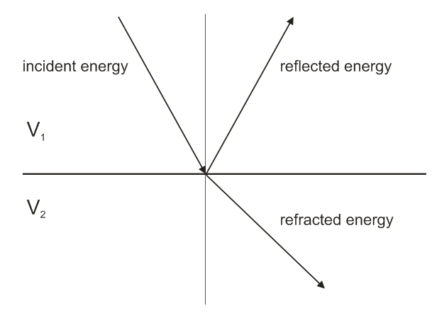
Q. What happens when a seismic wave encounters a velocity discontinuity?

Slide 25
Five important concepts
Seismic Wavefront
Ray
Huygen’s Principle
Snell’s Law
Reciprocity

Slide 26
Q. What is a seismic wavefront?

Slide 27
Q. What is a seismic wavefront?
A. Surface of constant phase, like ripples on a pond, but in three dimensions.

Slide 28
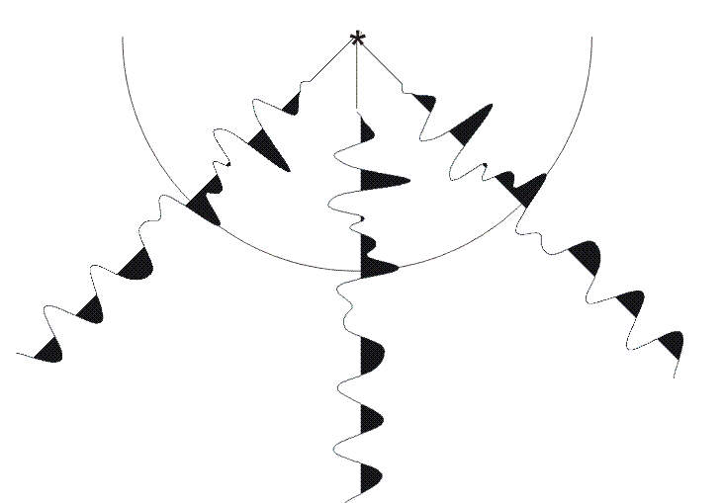
Q. What is a seismic wavefront?

Slide 29
The speed at which a wavefront travels is the seismic velocity of the material, and depends on the material’s elastic properties. In a homogenious medium, a wavefront is spherical, and its shape is distorted by changes in the seismic velocity.

Slide 30
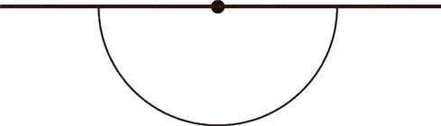
Seismic wavefront

Slide 31
Q. What is a ray?

Slide 32
Q. What is a ray?
A. Also referred to as a “wavefront
normal” a ray is an arrow
perpendicular to the wave front,
indicating the direction of travel at
that point on the wavefront. There
are an infinite number of rays on a
wave front.

Slide 33
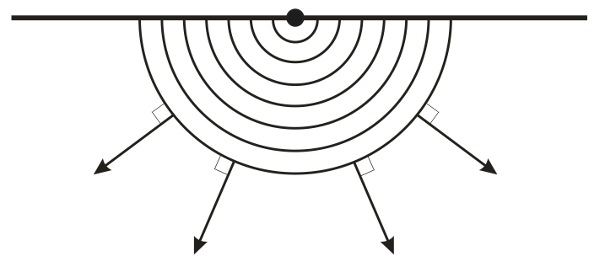
Ray

Slide 34
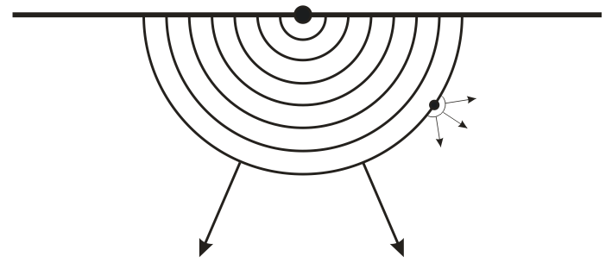
Huygens' Principle
Every point on a wave front can be thought of as a new point source for waves generated in the direction the wave is traveling or being propagated.

Slide 35
Q. What causes refraction?

Slide 36
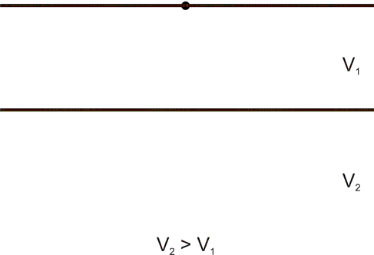
Q. What causes refraction?
A. Different portions of the wave front reach the velocity boundary earlier than other portions, speeding up or slowing down on contact, causing distortion of wave front.

Slide 37
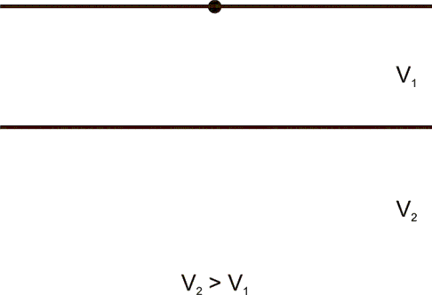

Slide 38
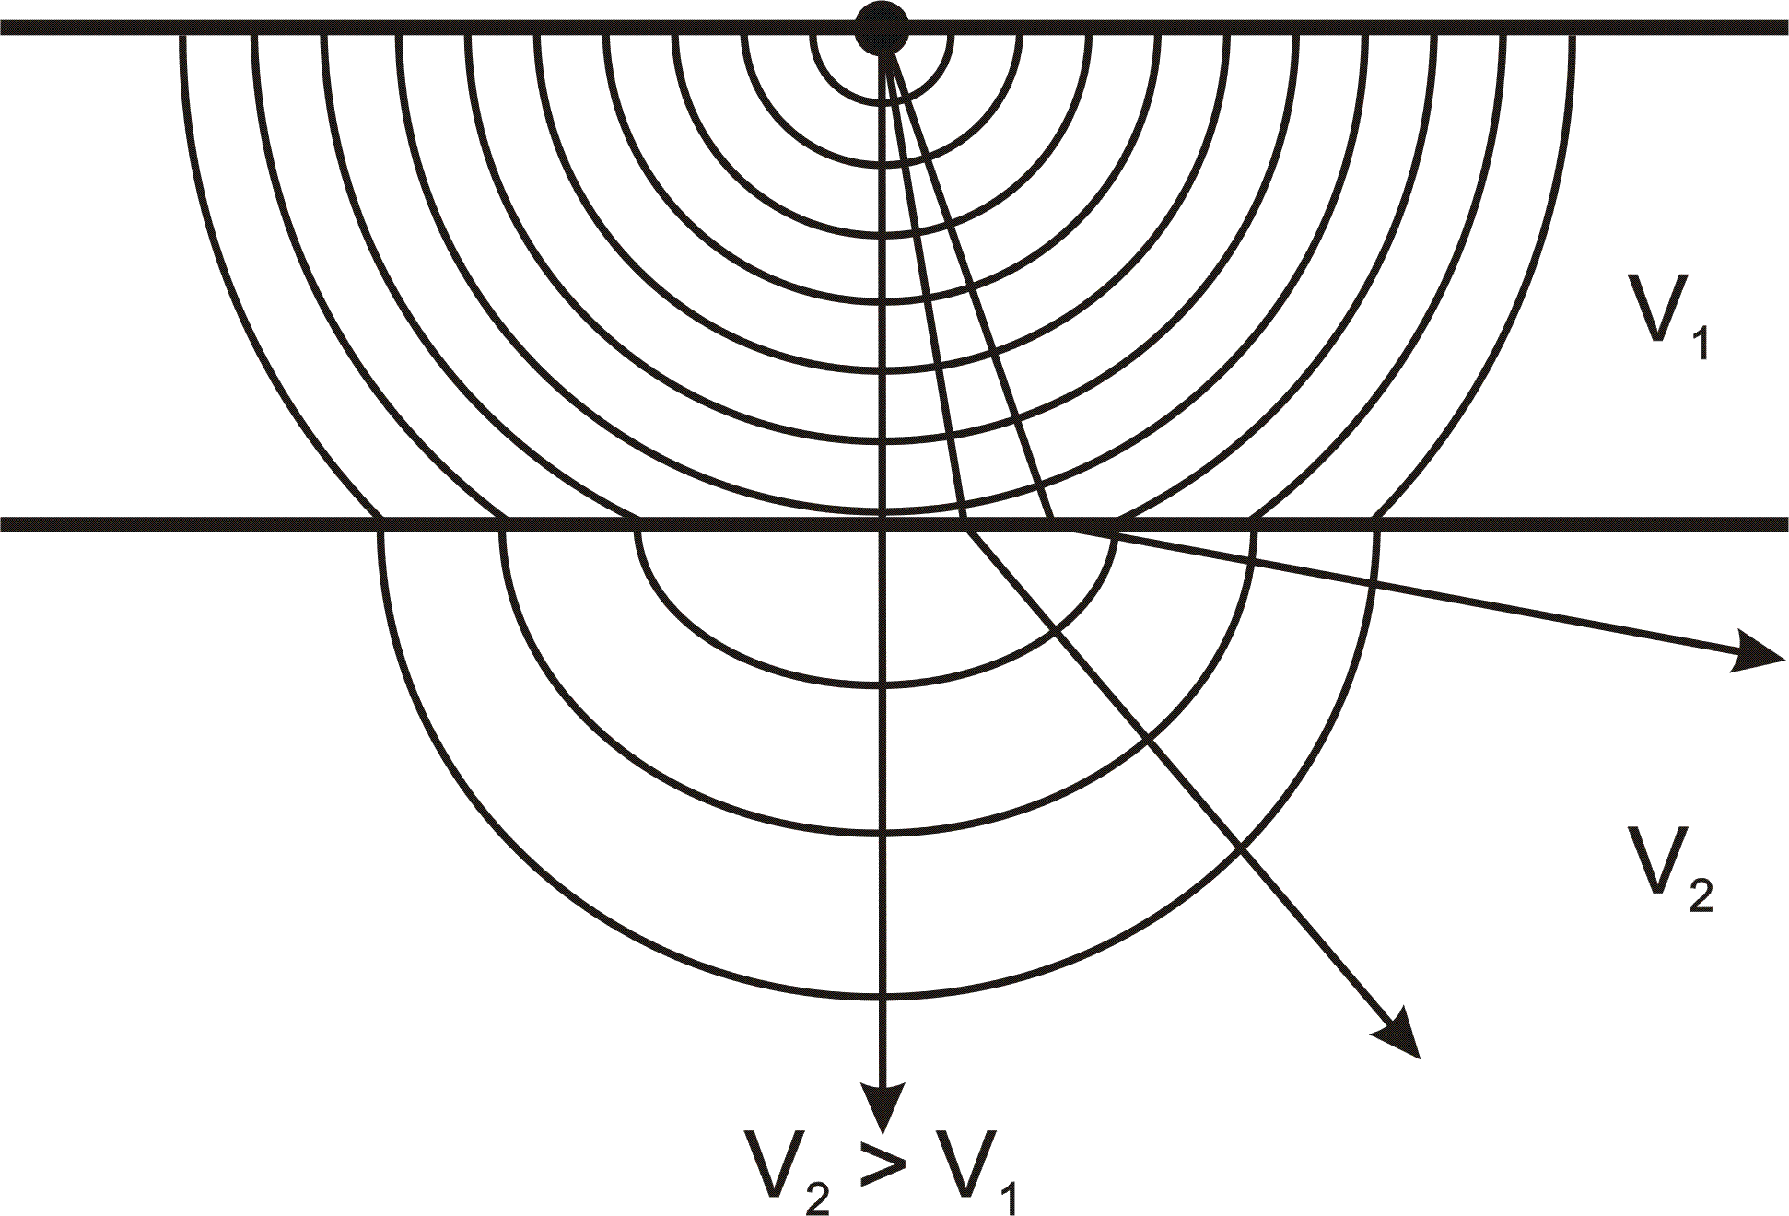

Slide 39
Understanding and Quantifying How Waves Refract is Essential

Slide 40
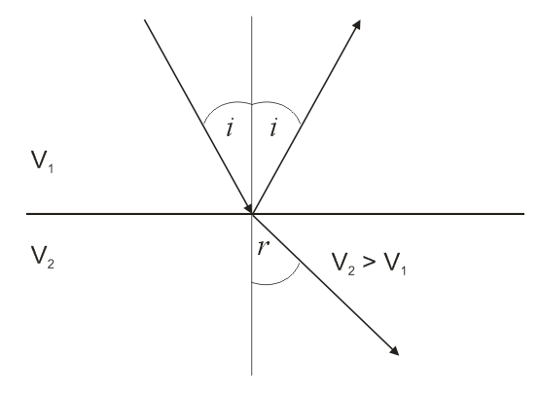
Snell’s Law
(1)

Slide 41
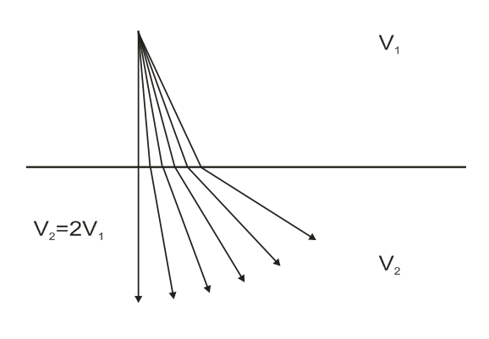
Snell’s Law
If V₂>V₁, then as i increases, r increases faster

Slide 42
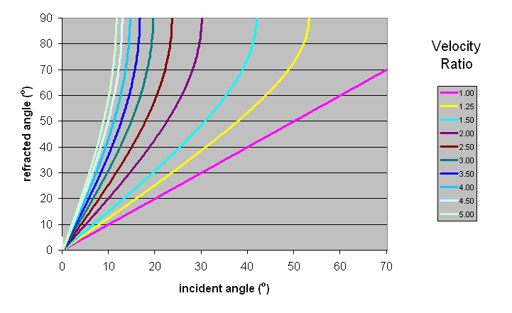
Snell’s Law
r approaches 90º as i increases

Slide 43
Snell’s Law
Critical Refraction
At Critical Angle of incidence i_{c}, angle of refraction r = 90º
(2)
(3)

Slide 44
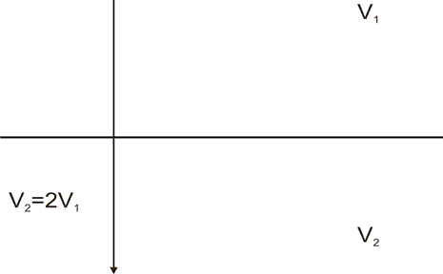
Snell’s Law
Critical Refraction
At Critical Angle of incidence i_{c}, angle of refraction r = 90º

Slide 45
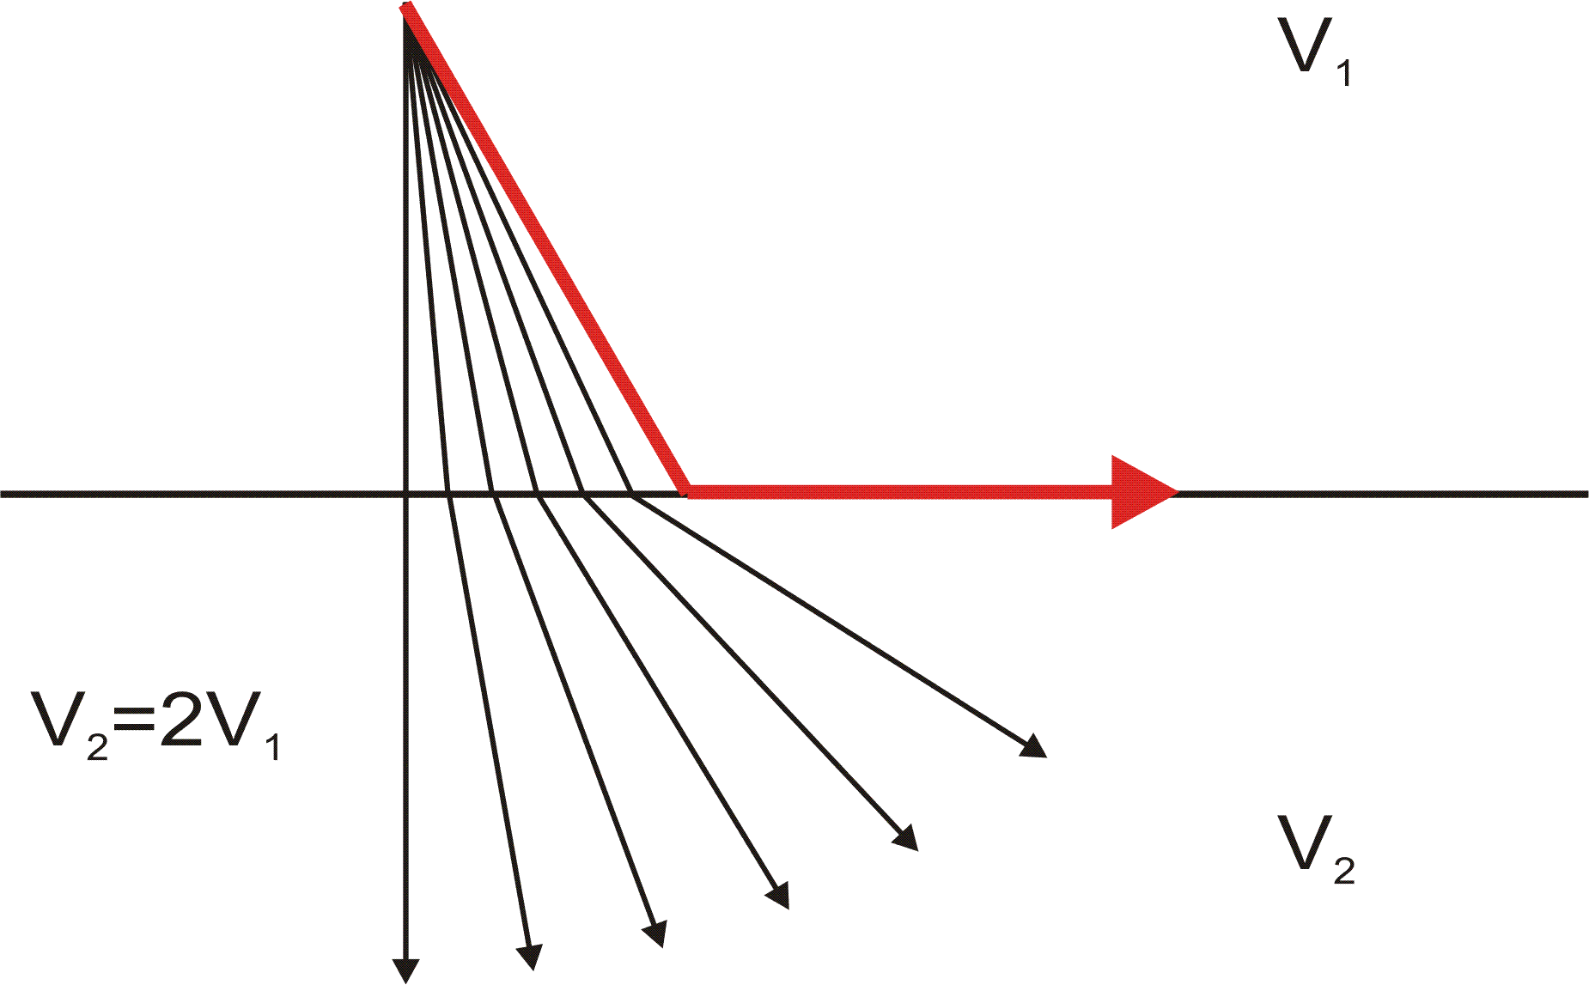
Snell’s Law
Critical Refraction
At Critical Angle of incidence i_{c}, angle of refraction r = 90º

Slide 46
Snell’s Law
Critical Refraction
Seismic refraction makes use of critically refracted, first-arrival energy only. The rest of the wave form is ignored.

Slide 47
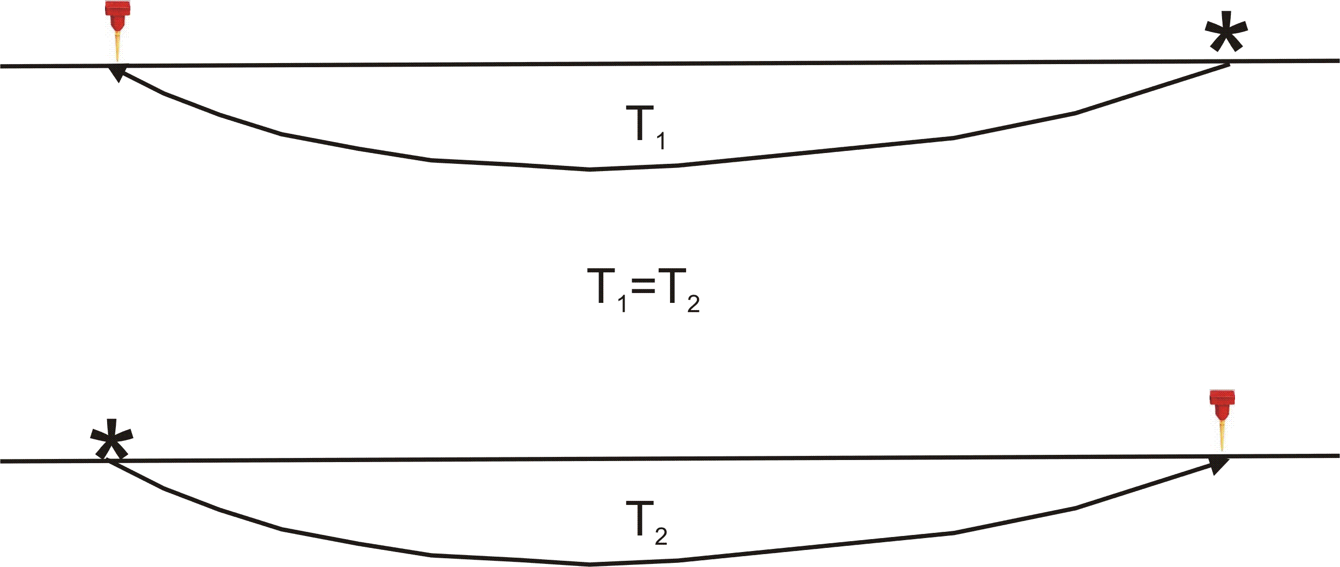
Principal of Reciprocity
The travel time of seismic energy between two points is independent of the direction traveled, i.e., interchanging the source and the geophone will not affect the seismic travel time between the two.

Slide 48
Using Seismic Refraction to Map the Subsurface
Critical Refraction Plays a Key Role

Slide 49
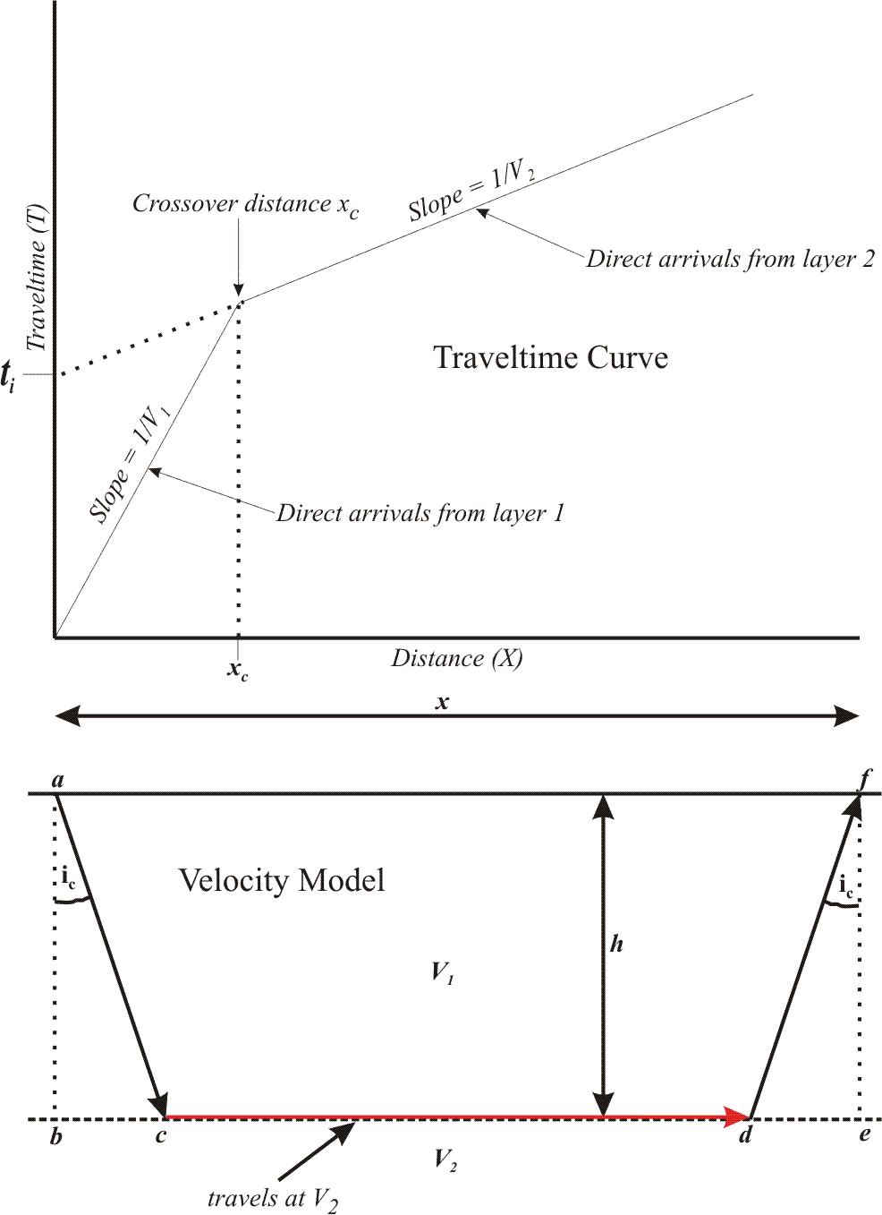

Slide 50
(Snell’s Law)

Slide 51
From Snell’s Law,
(4)

Slide 52
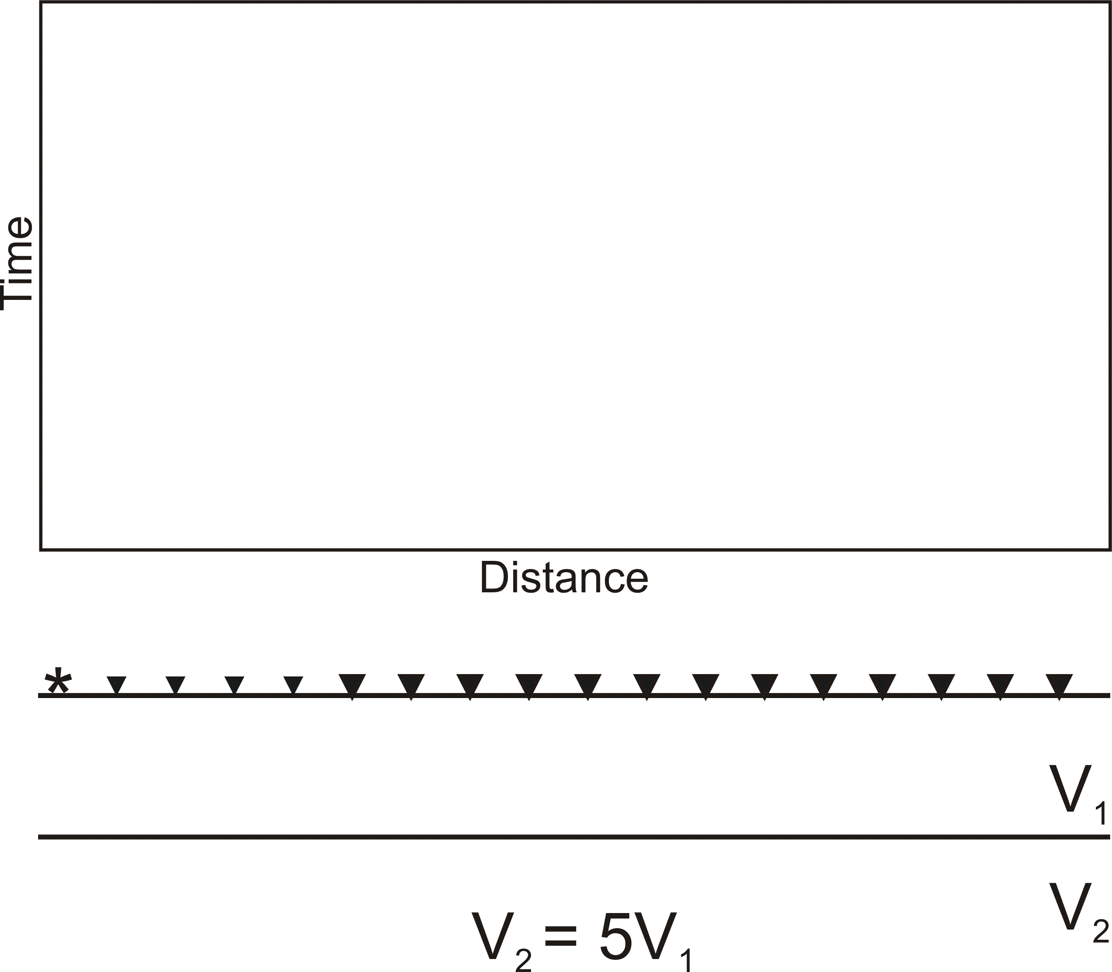
Using Seismic Refraction to Map the Subsurface

Slide 53
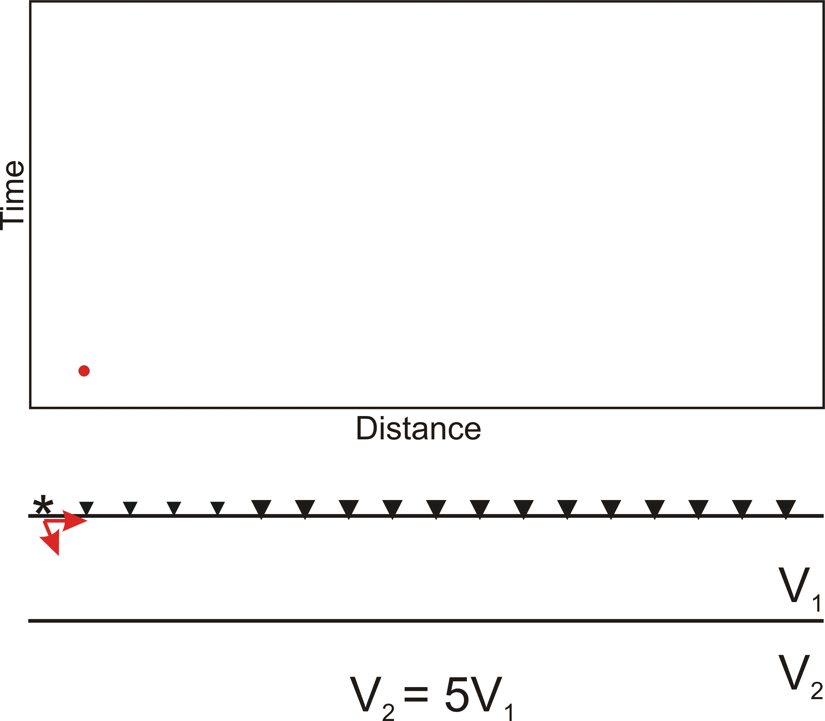
Using Seismic Refraction to Map the Subsurface

Slide 54
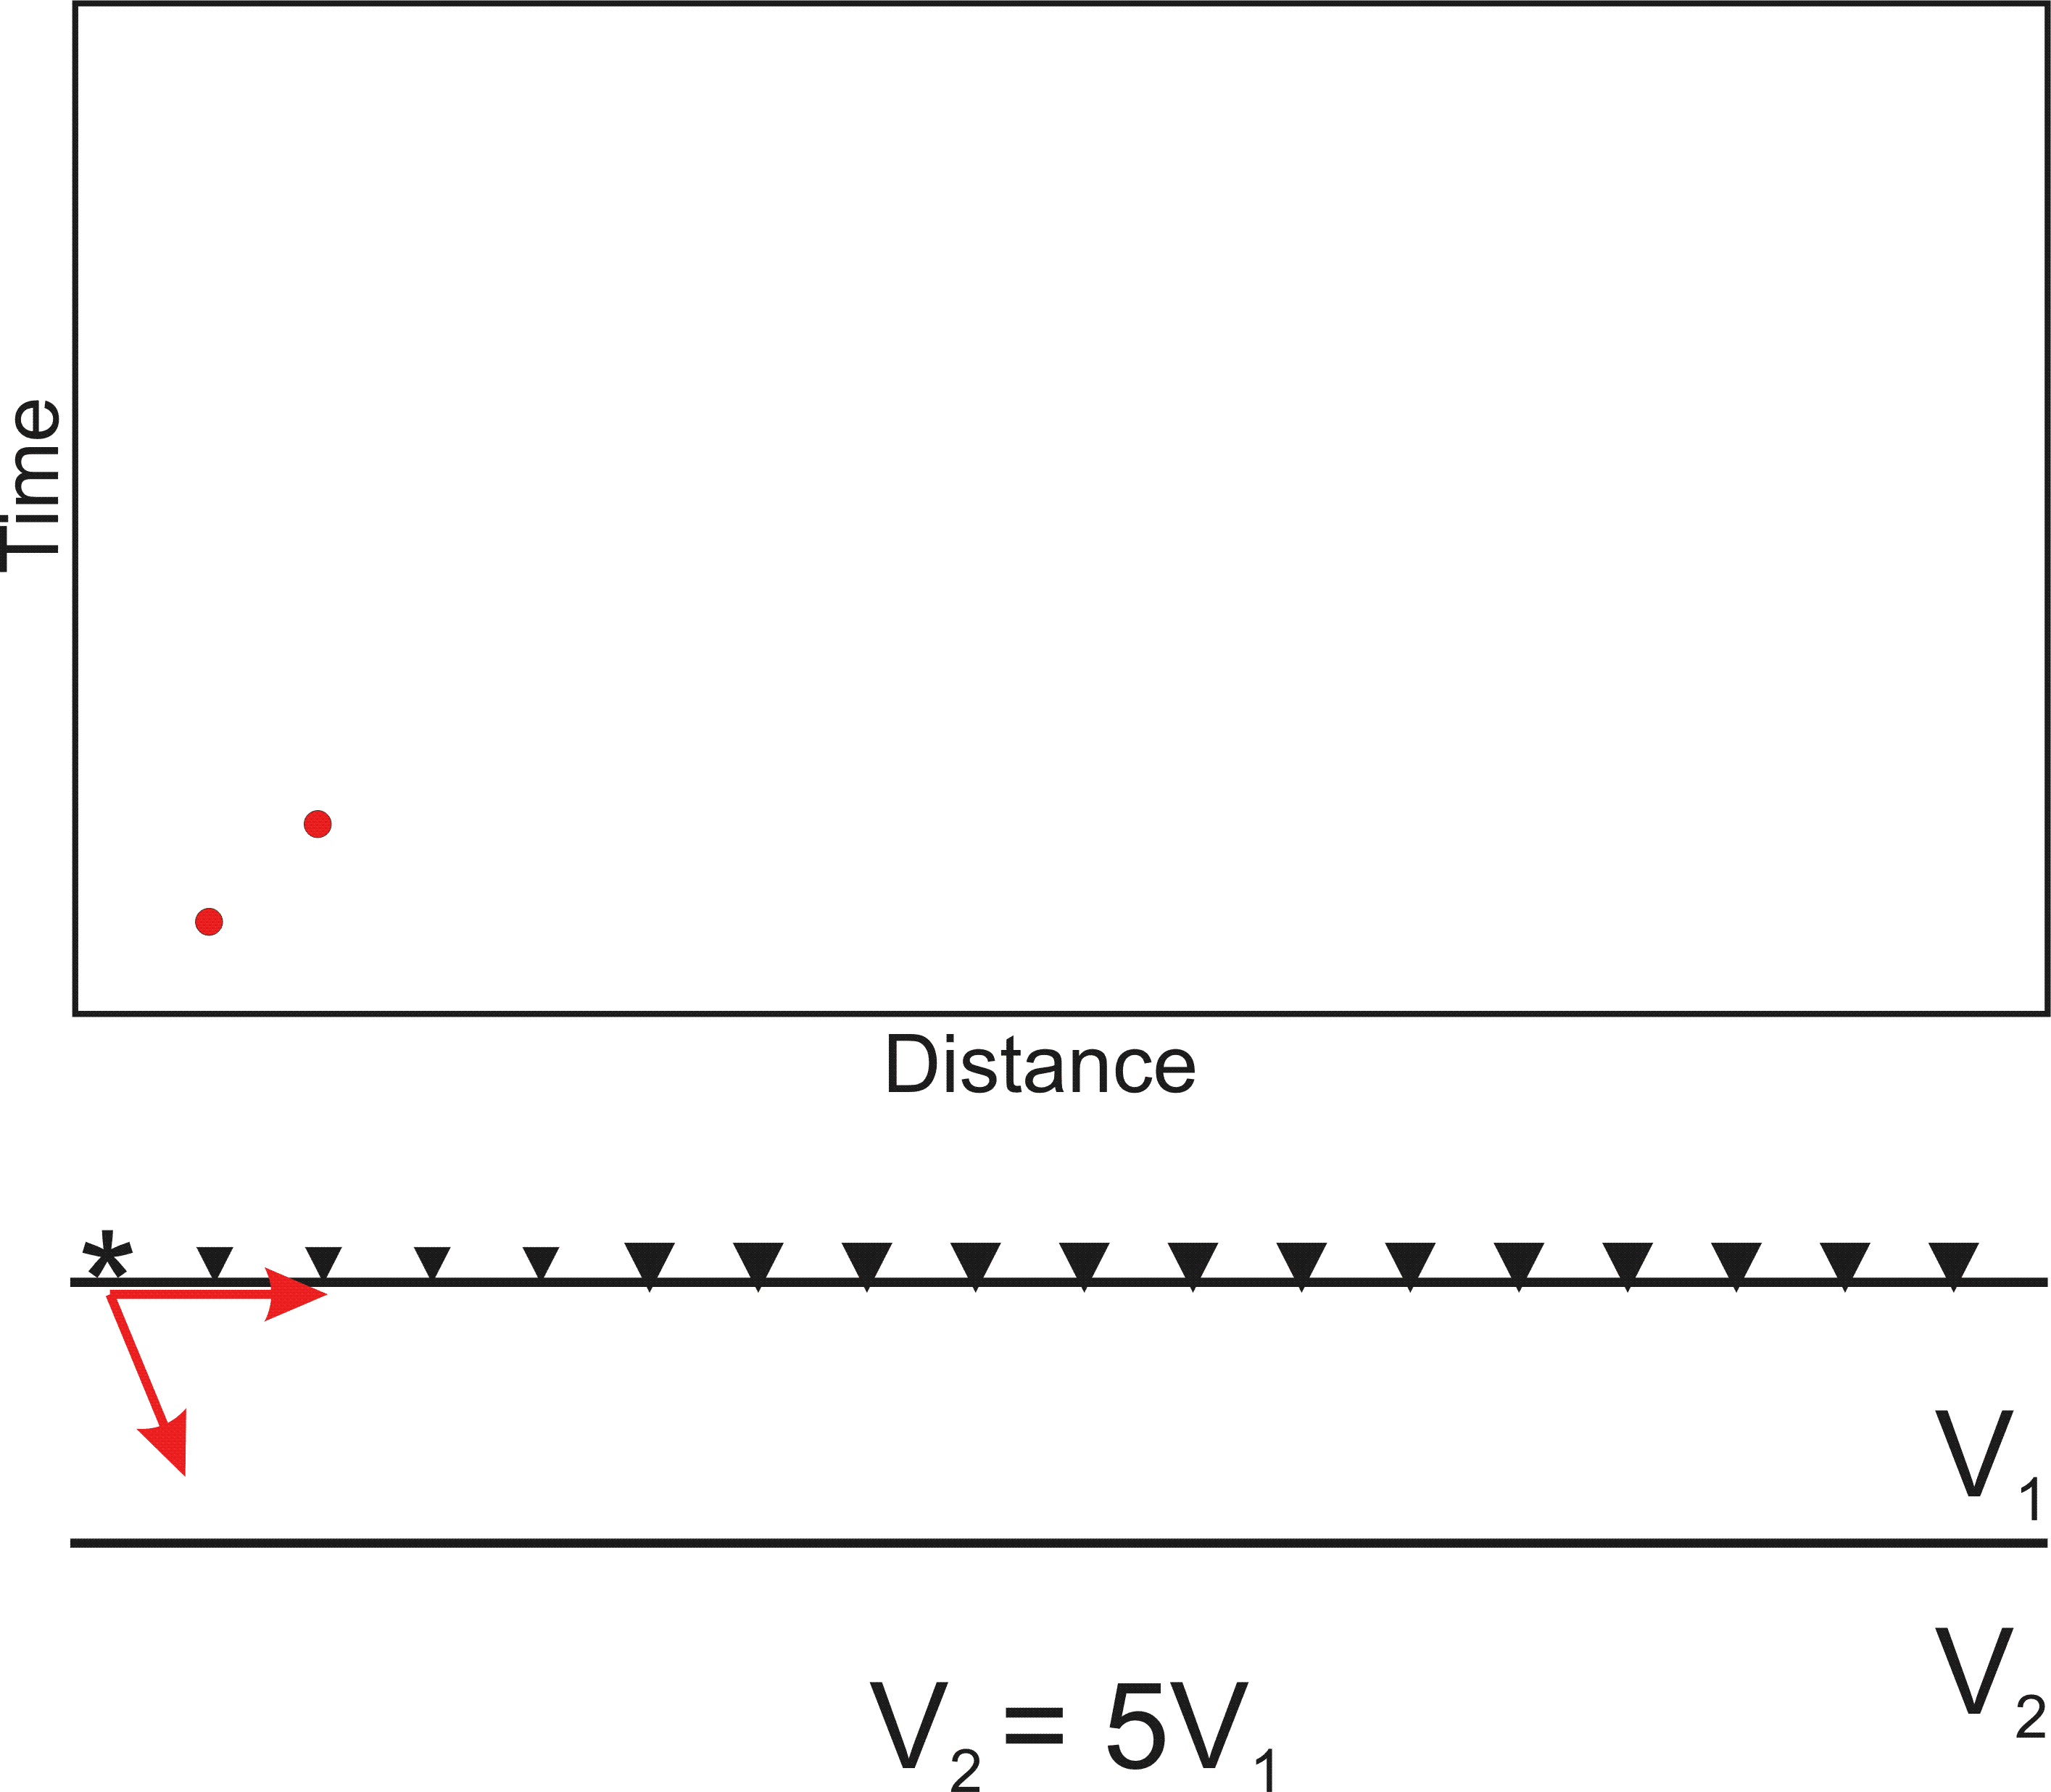
Using Seismic Refraction to Map the Subsurface

Slide 55
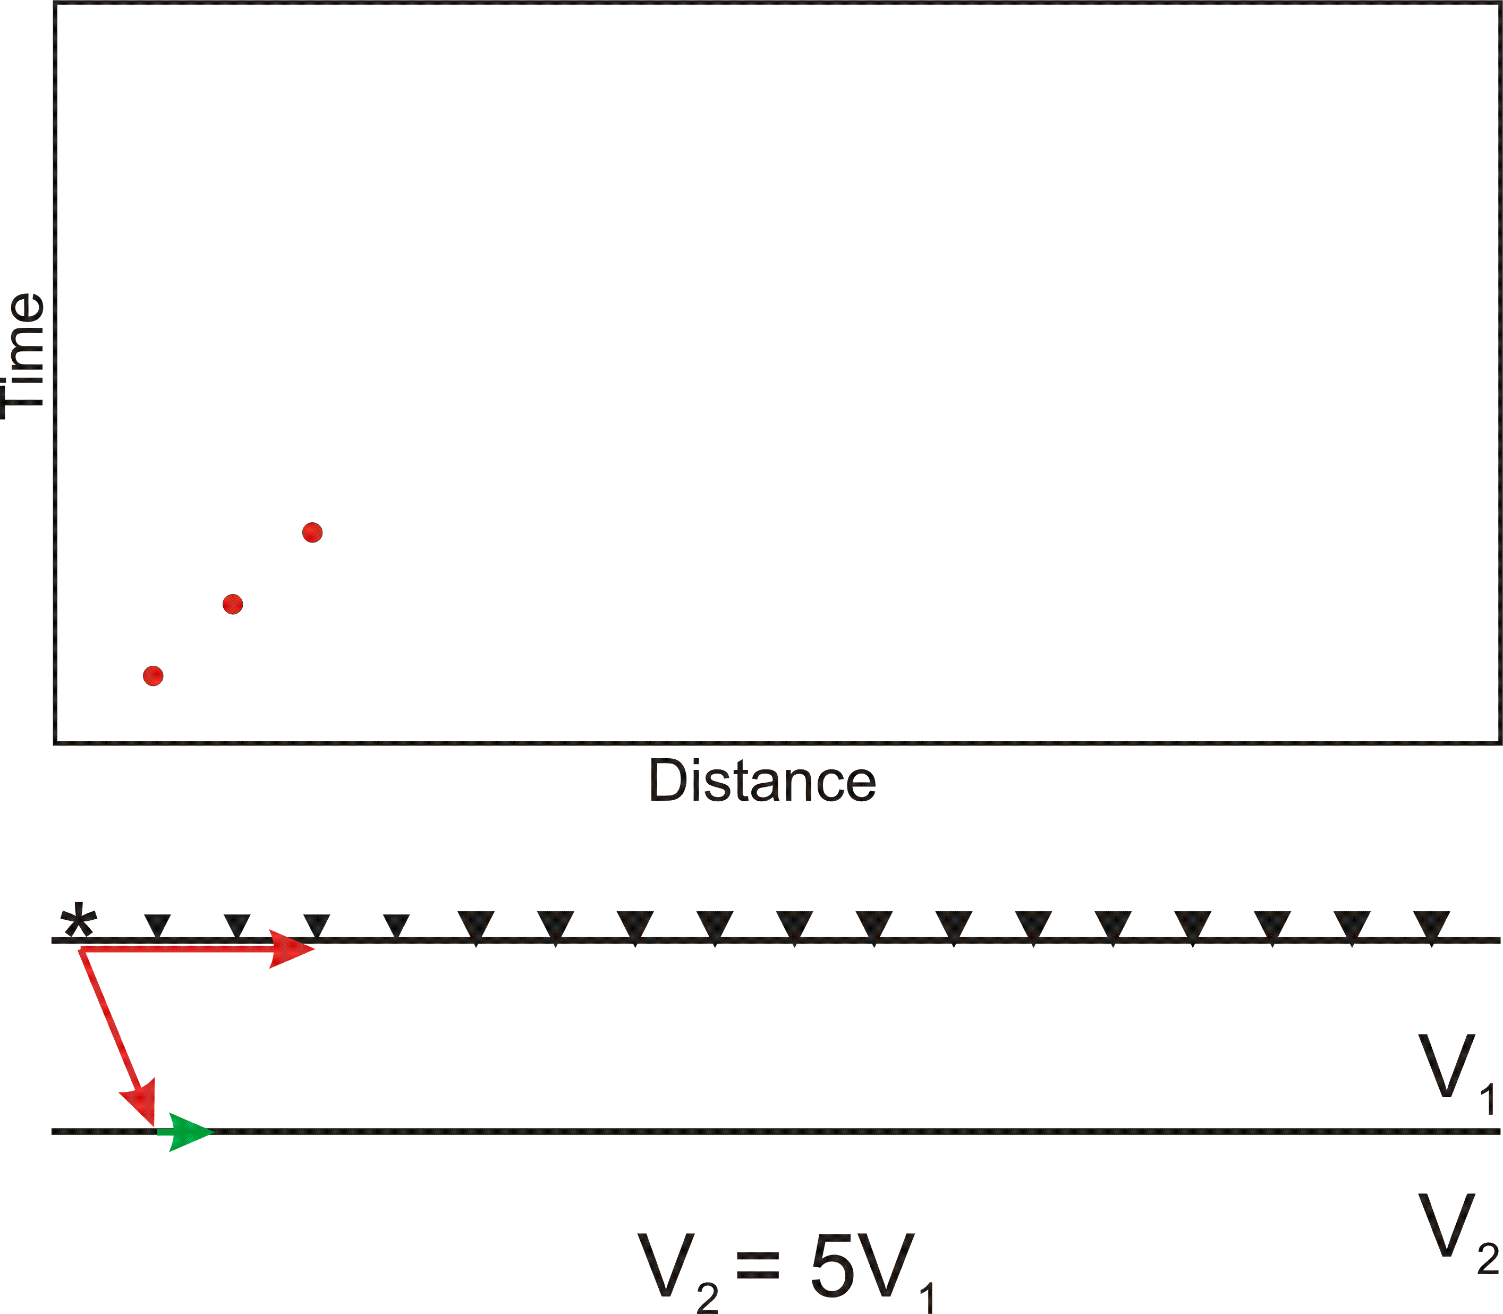
Using Seismic Refraction to Map the Subsurface

Slide 56
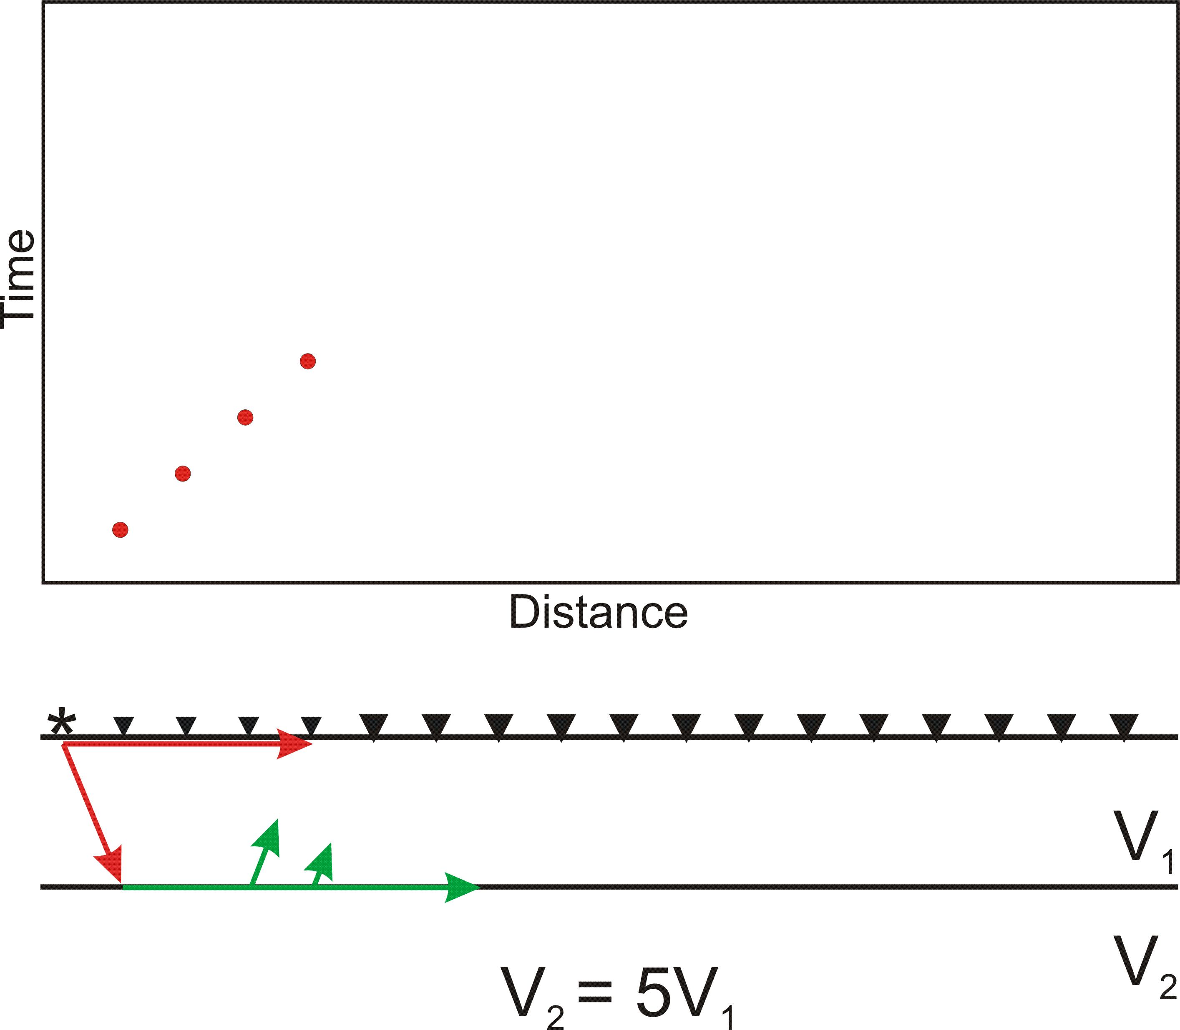
Using Seismic Refraction to Map the Subsurface

Slide 57
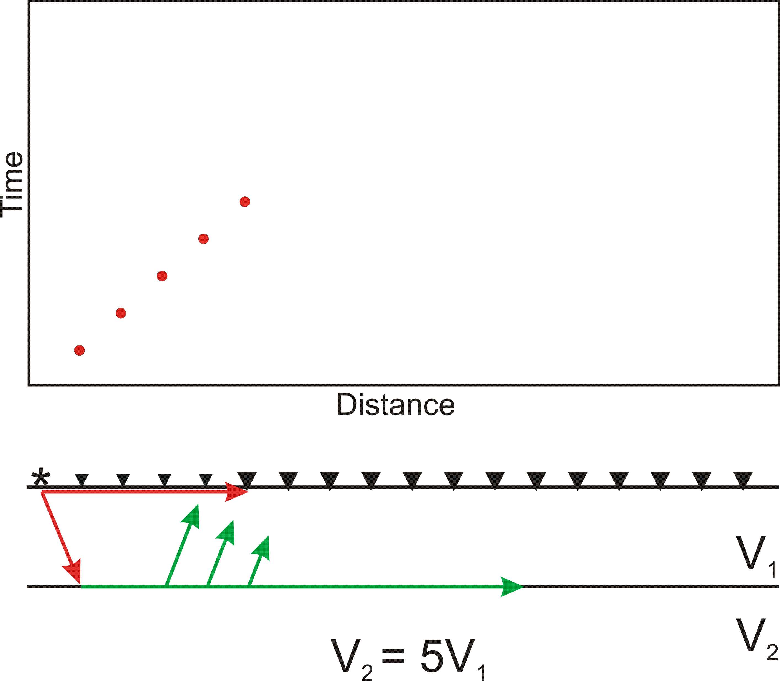
Using Seismic Refraction to Map the Subsurface

Slide 58
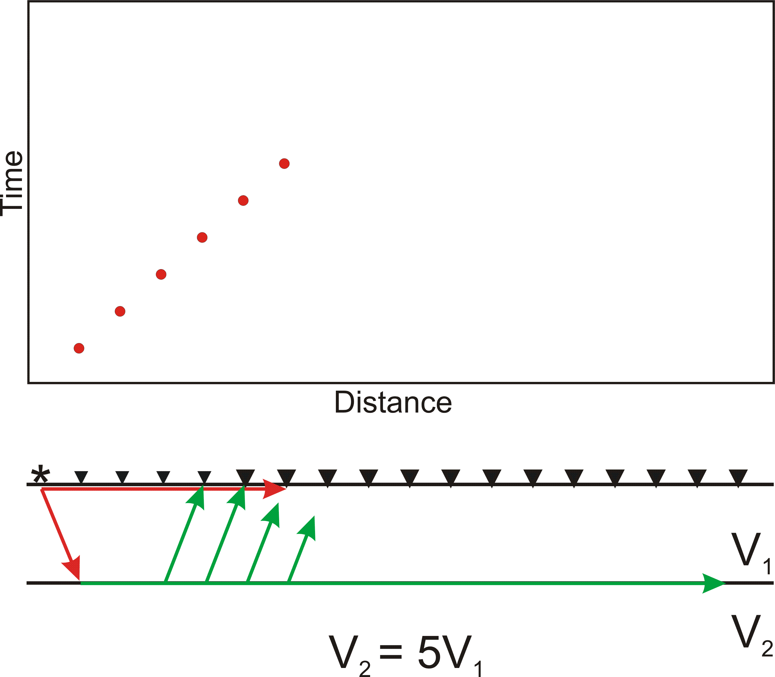
Using Seismic Refraction to Map the Subsurface

Slide 59
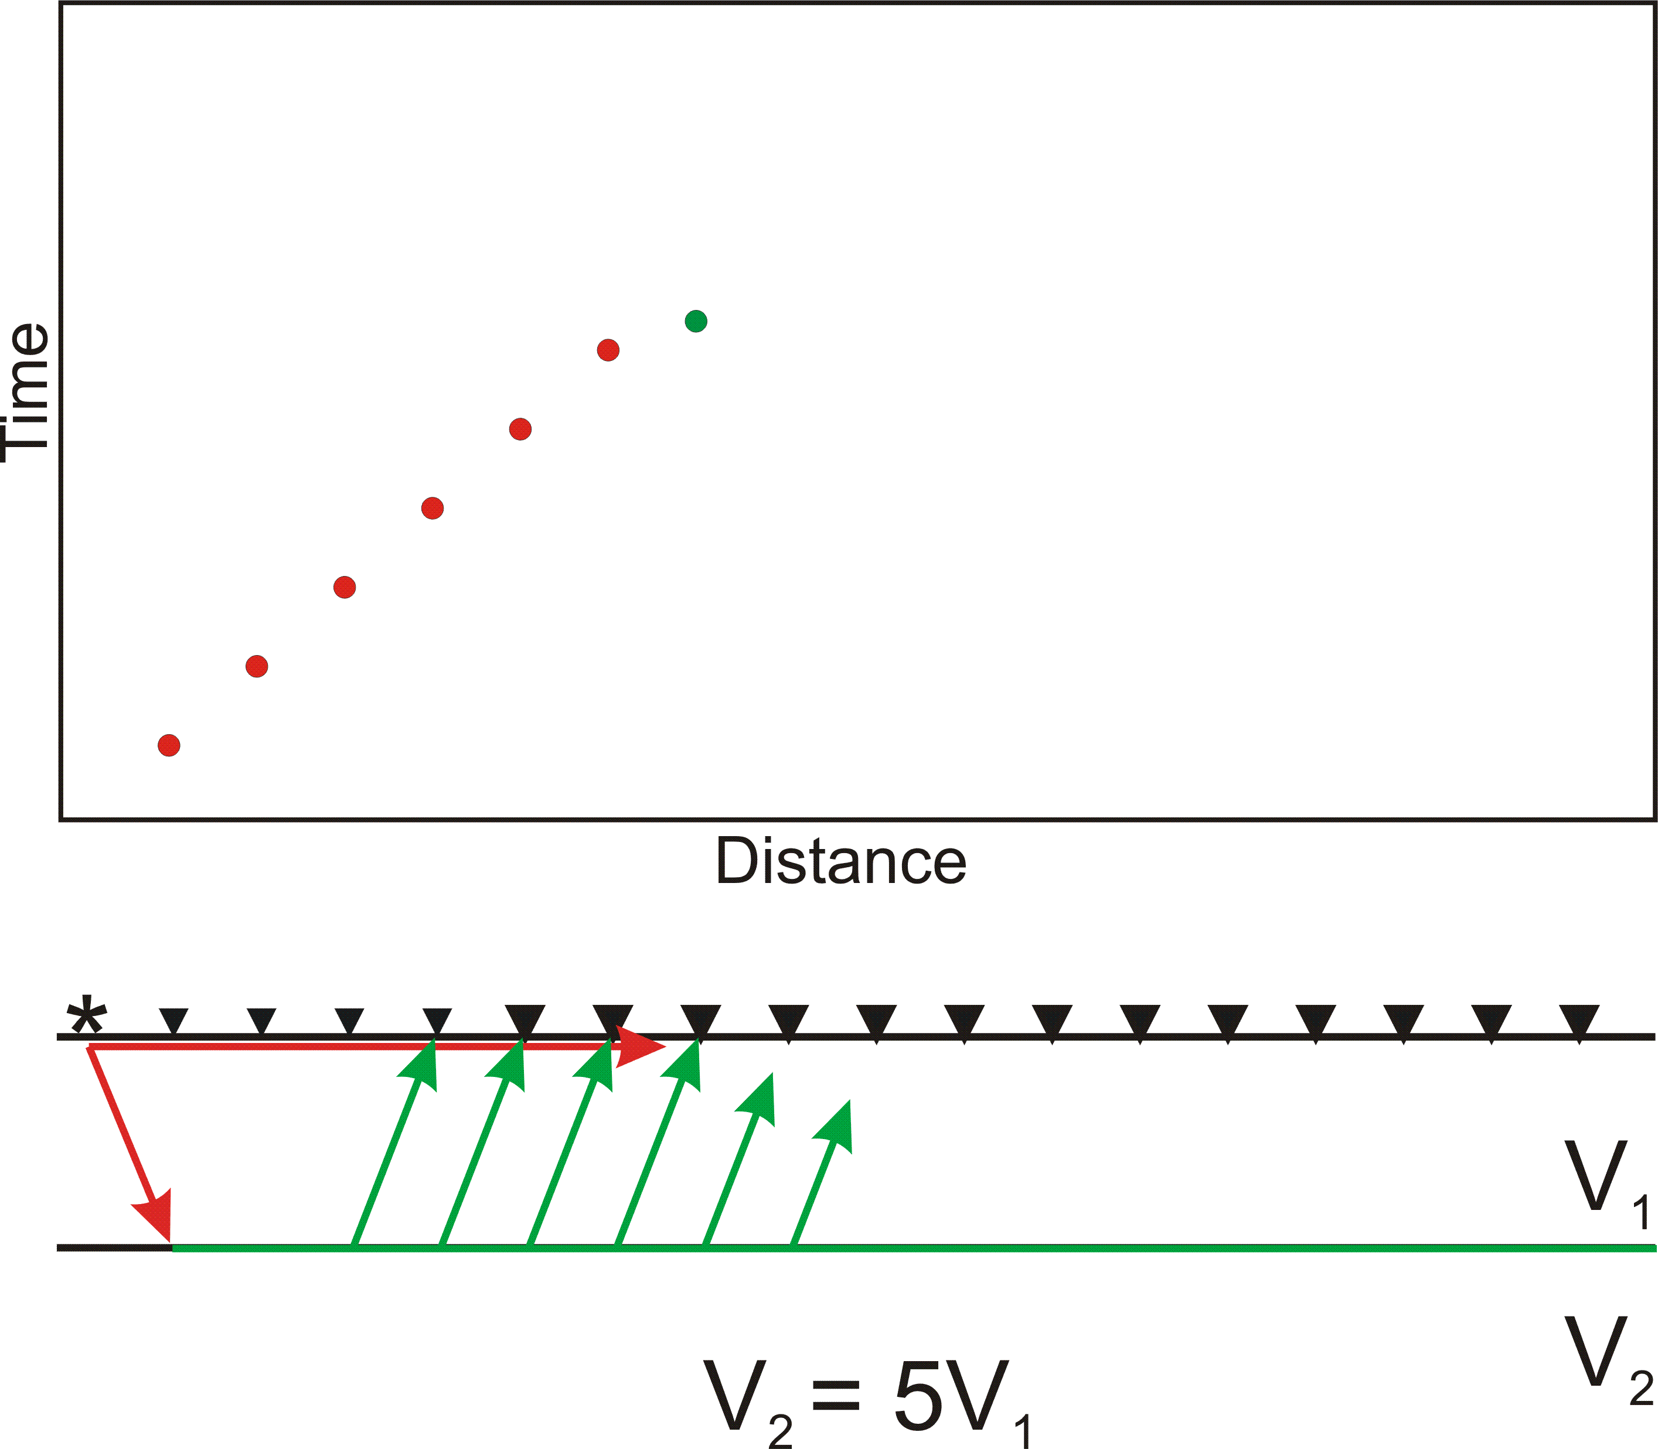
Using Seismic Refraction to Map the Subsurface

Slide 60
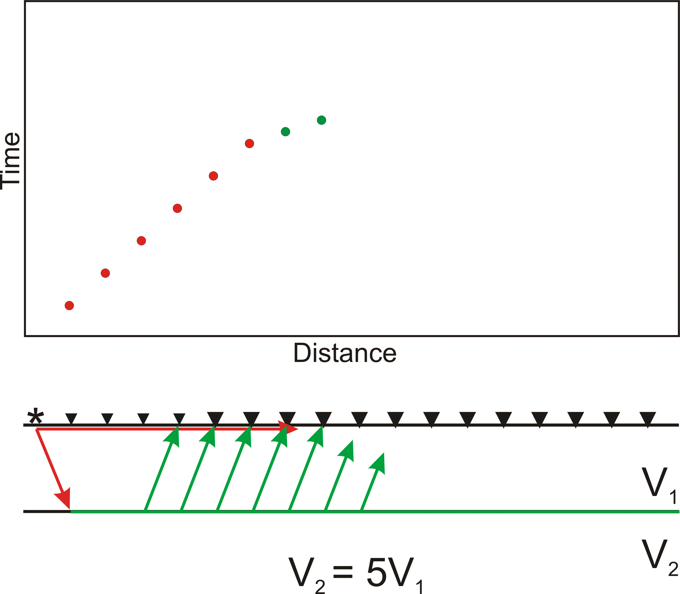
Using Seismic Refraction to Map the Subsurface

Slide 61
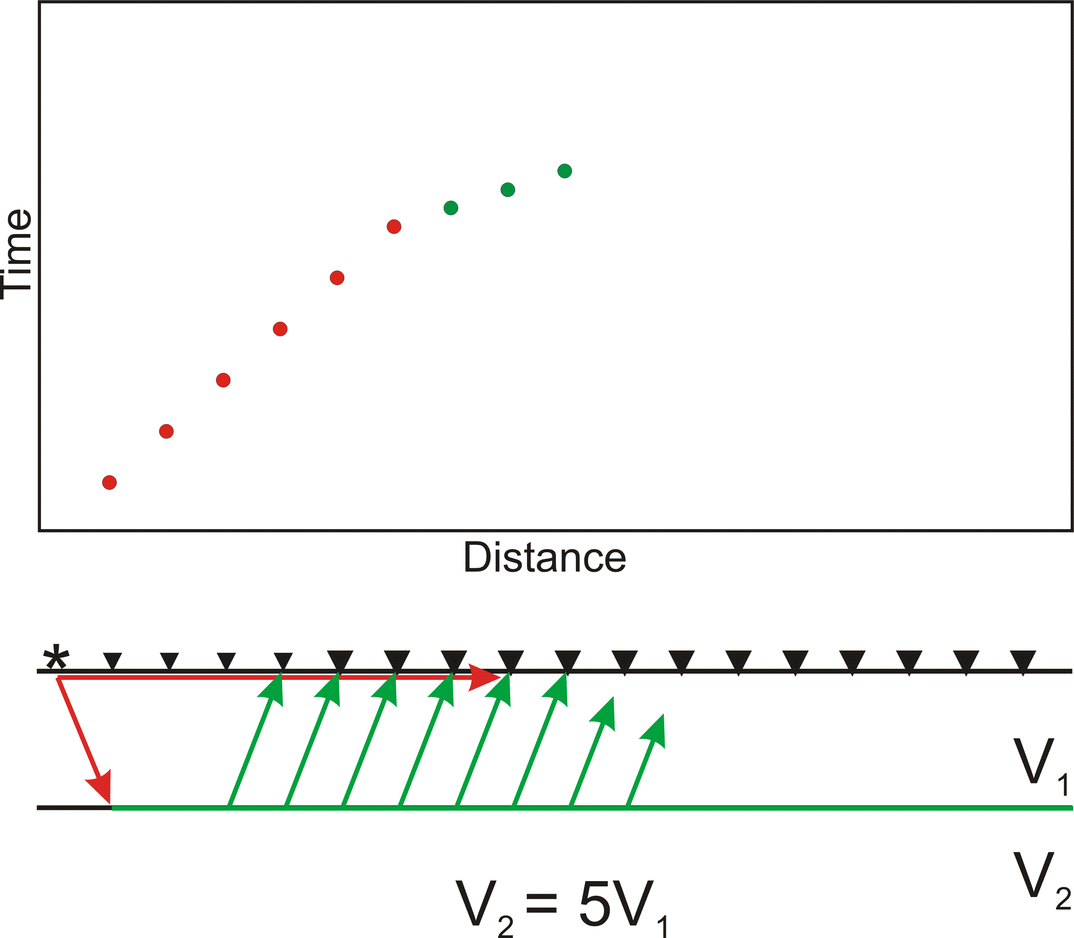
Using Seismic Refraction to Map the Subsurface

Slide 62
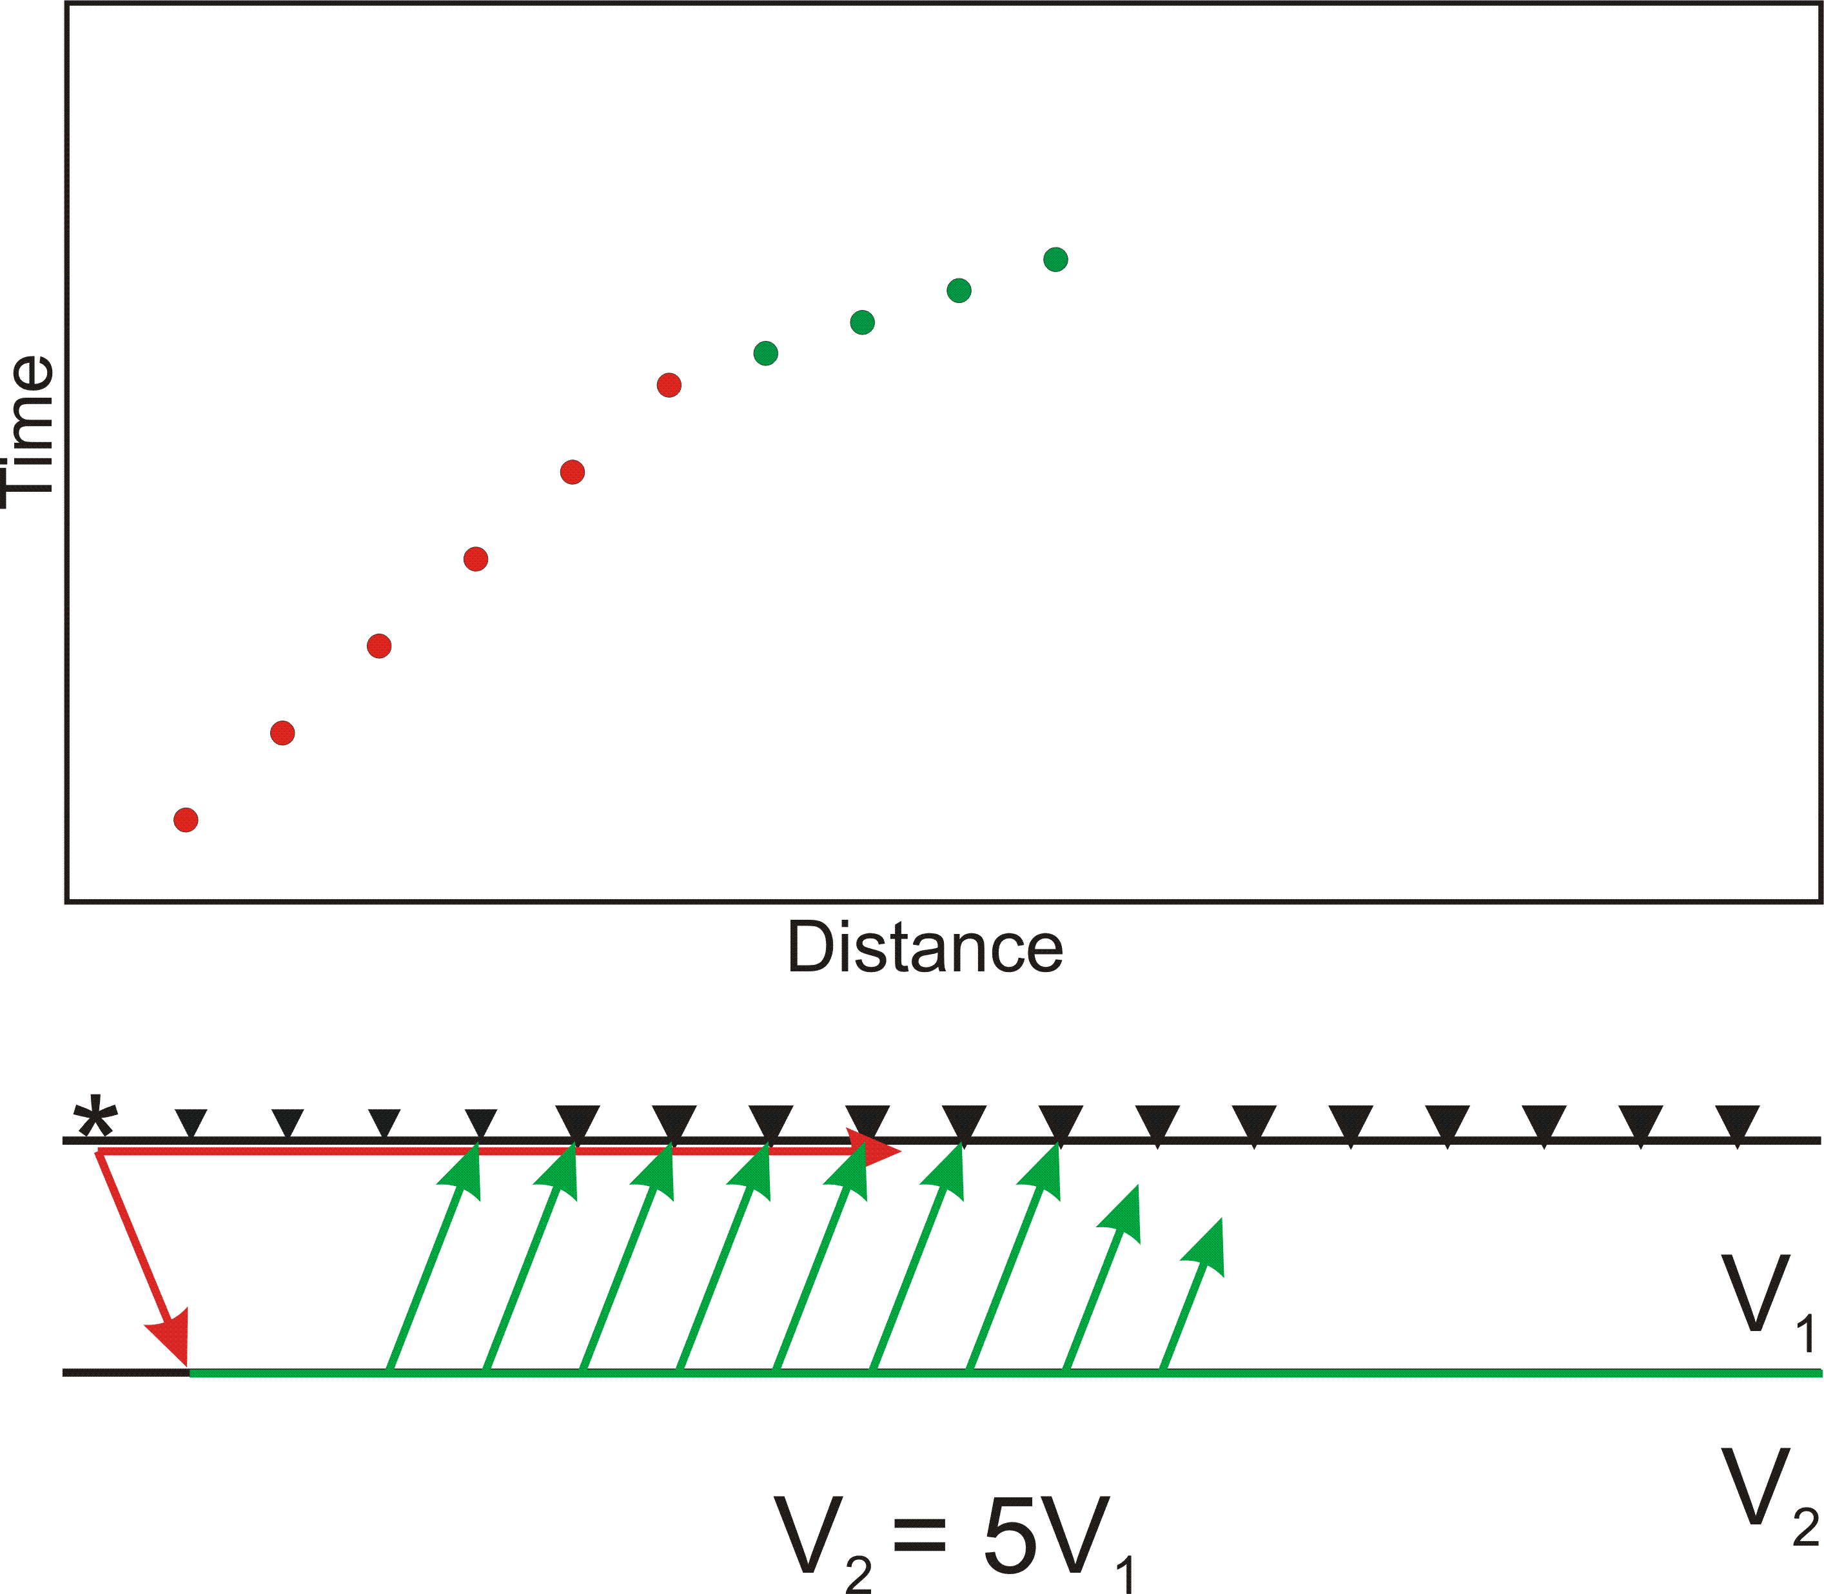
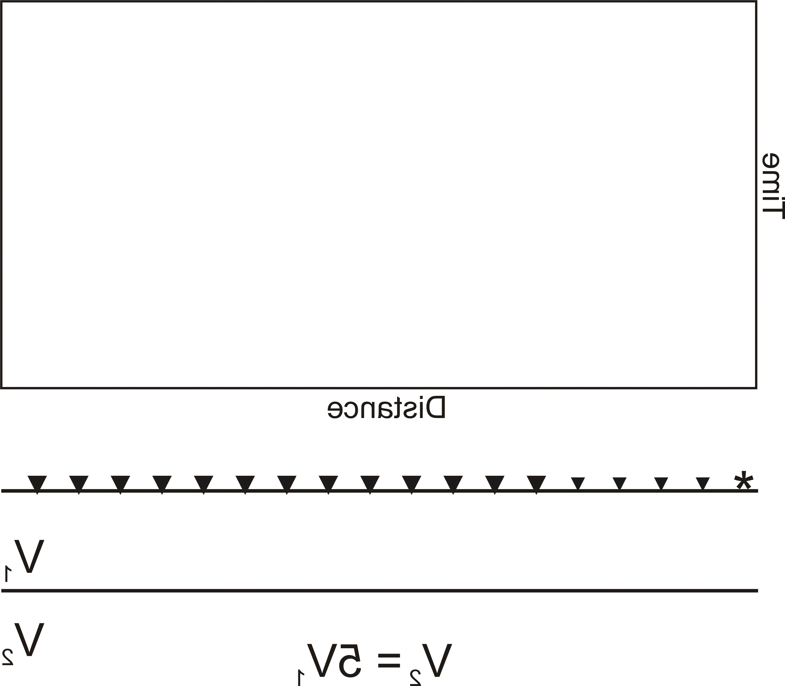
Using Seismic Refraction to Map the Subsurface

Slide 63
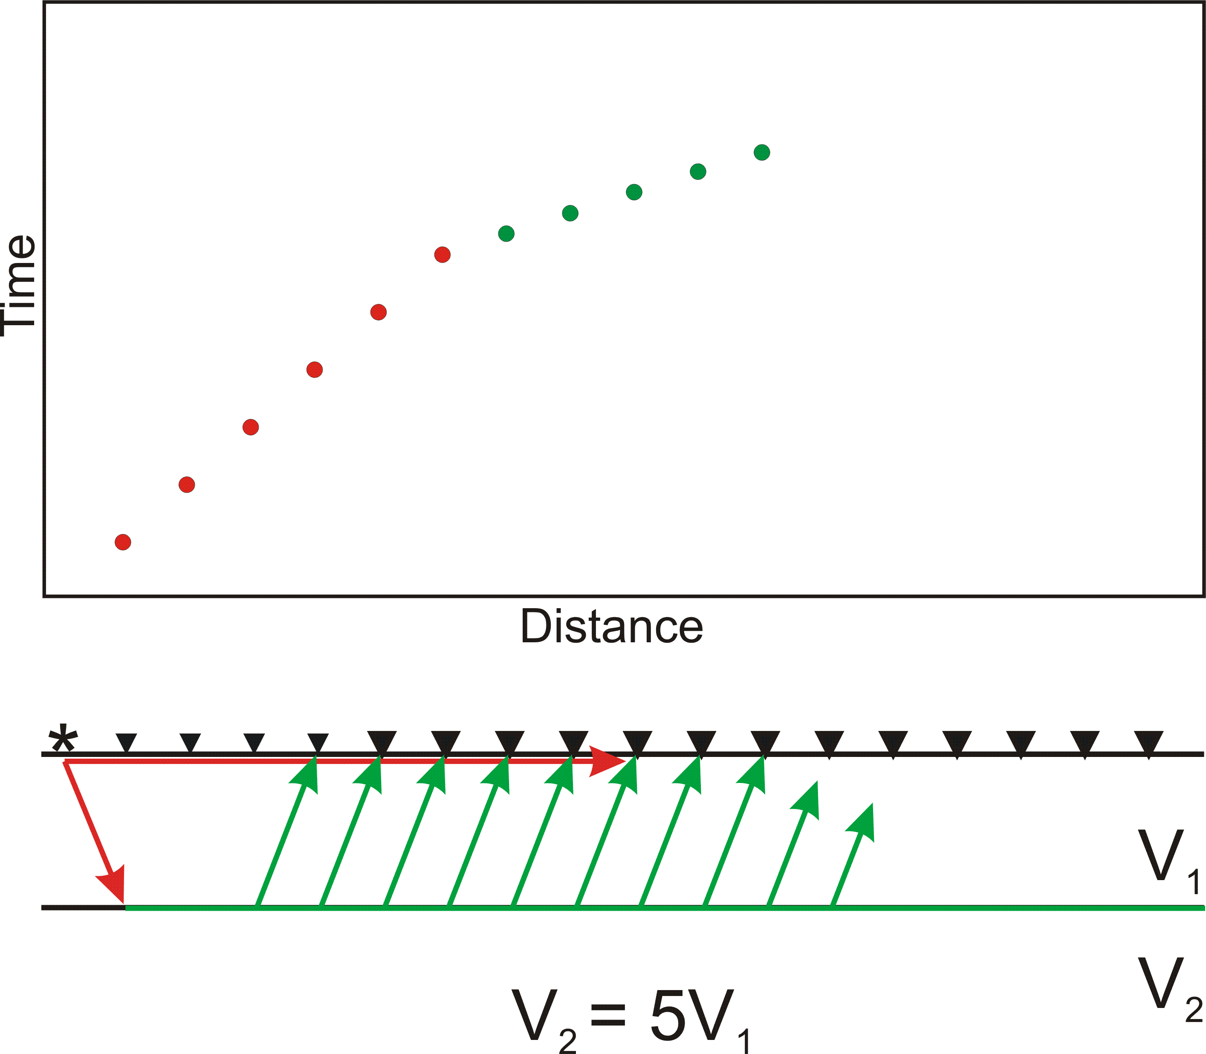
Using Seismic Refraction to Map the Subsurface

Slide 64
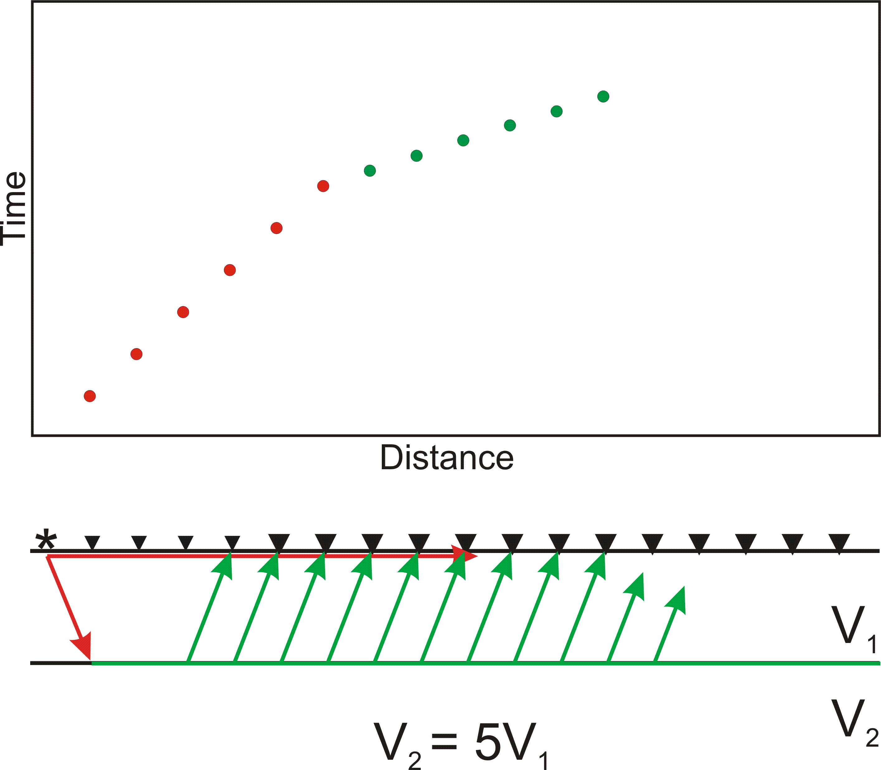
Using Seismic Refraction to Map the Subsurface

Slide 65
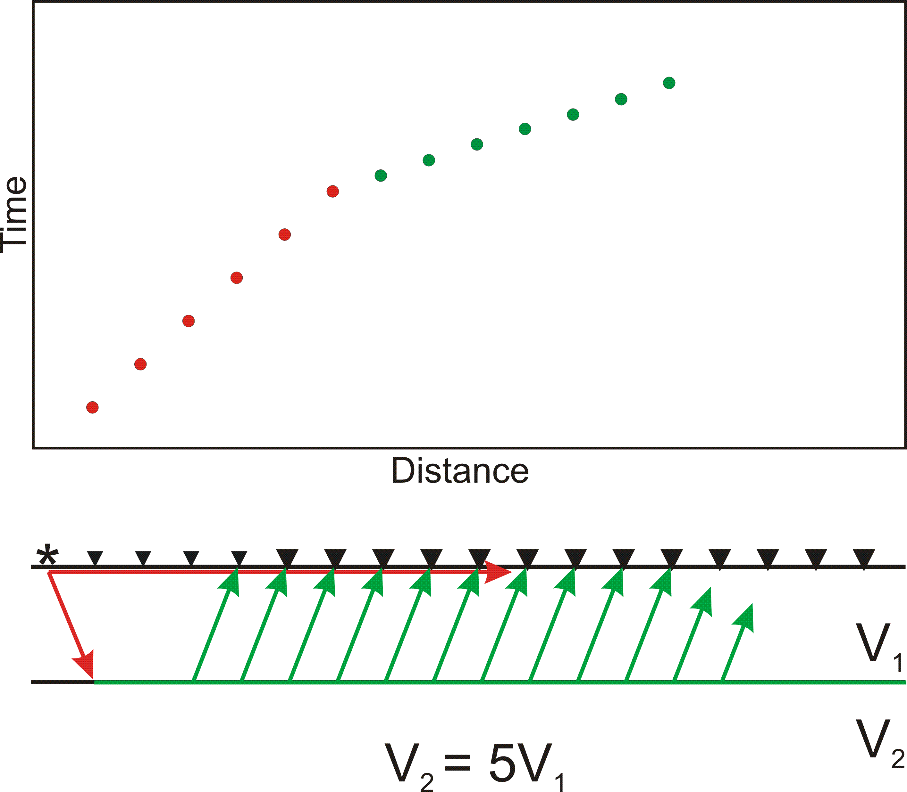
Using Seismic Refraction to Map the Subsurface

Slide 66
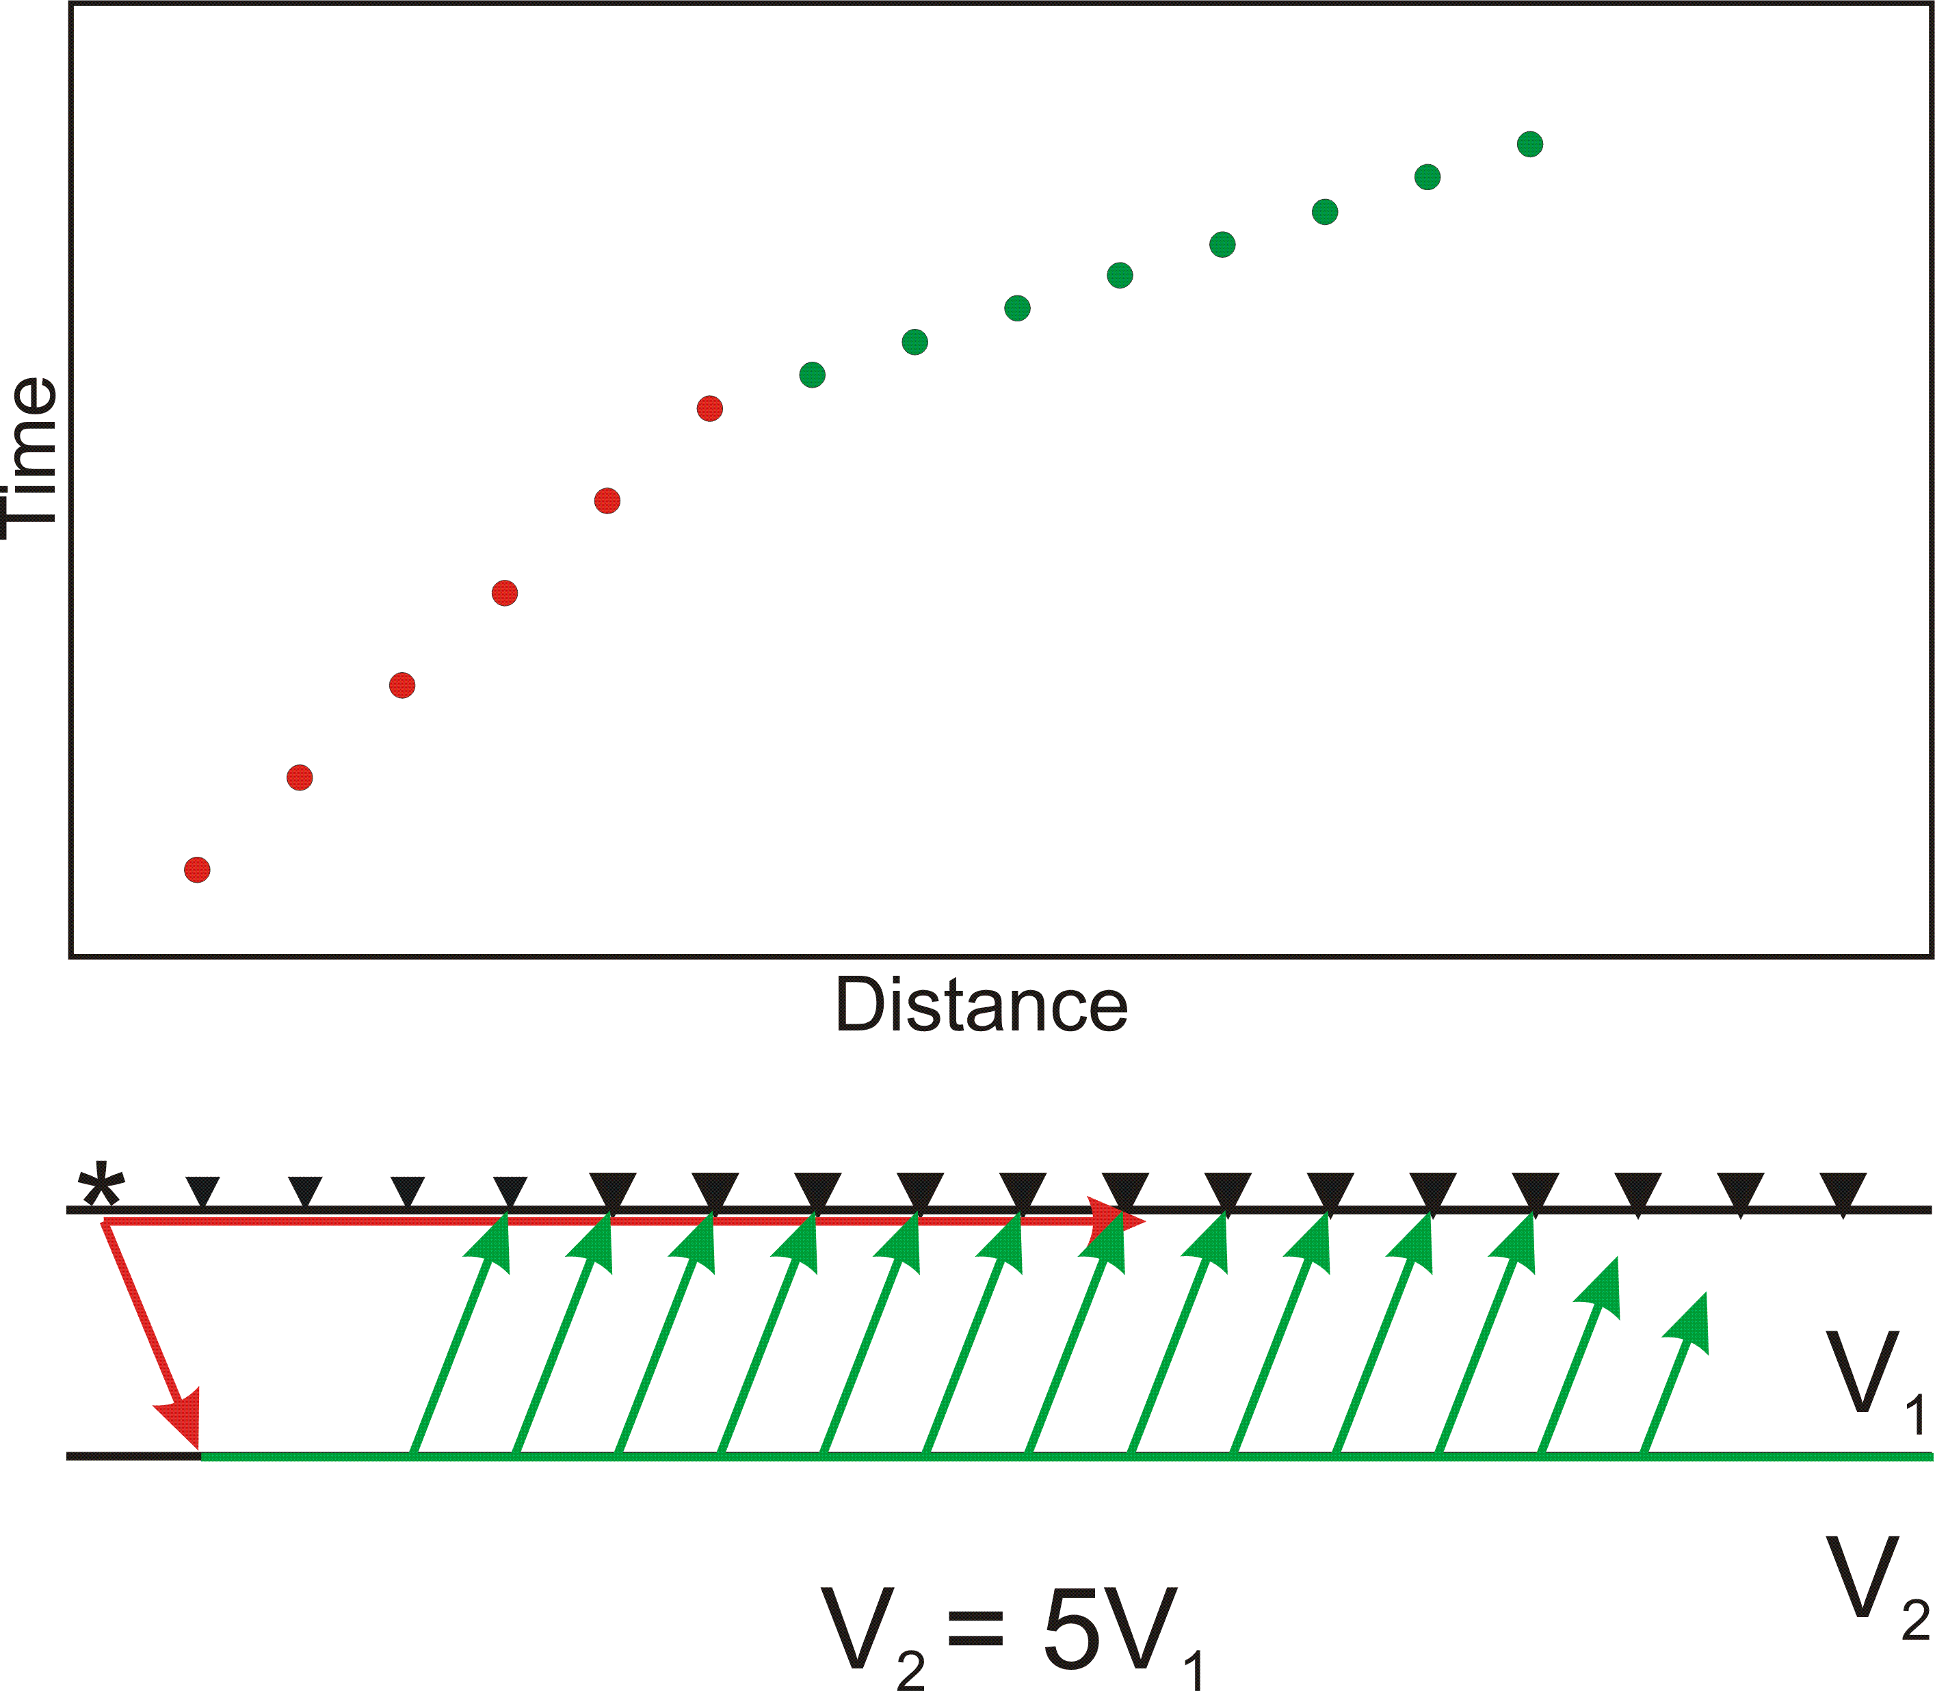
Using Seismic Refraction to Map the Subsurface

Slide 67
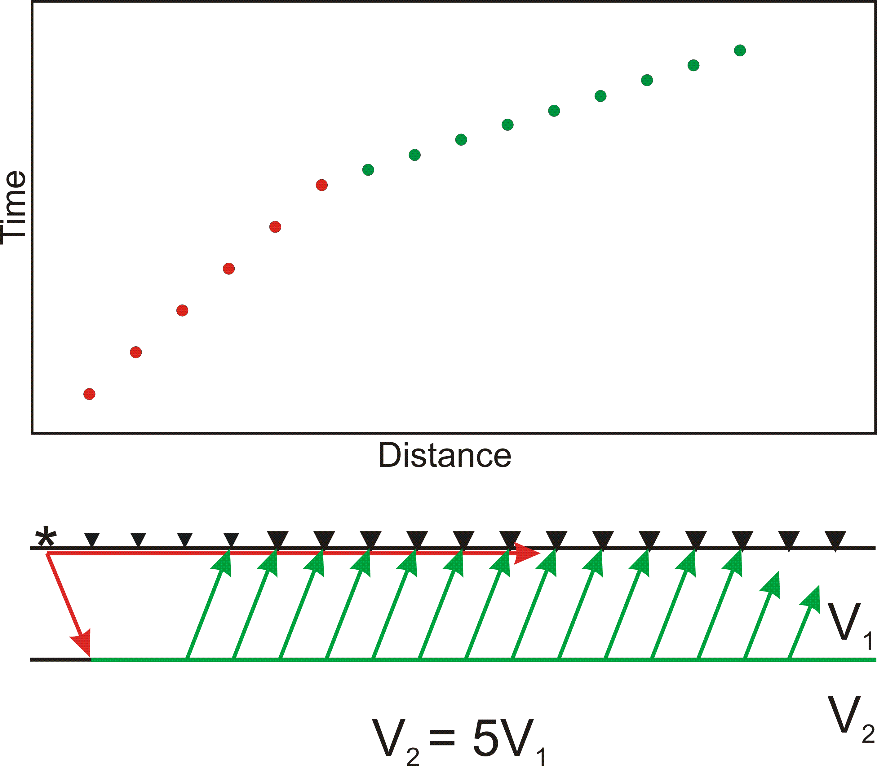
Using Seismic Refraction to Map the Subsurface

Slide 68
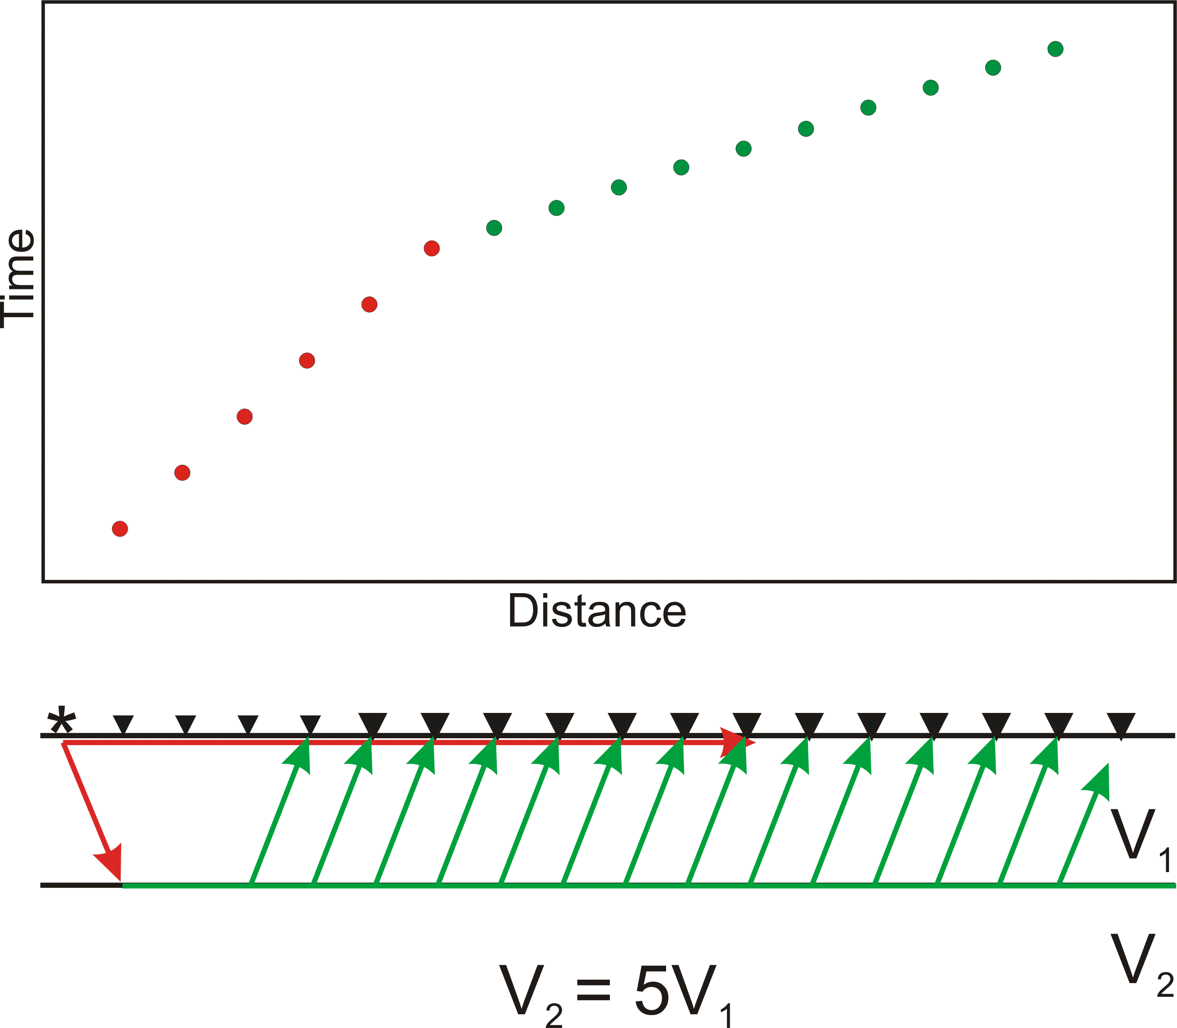
Using Seismic Refraction to Map the Subsurface

Slide 69
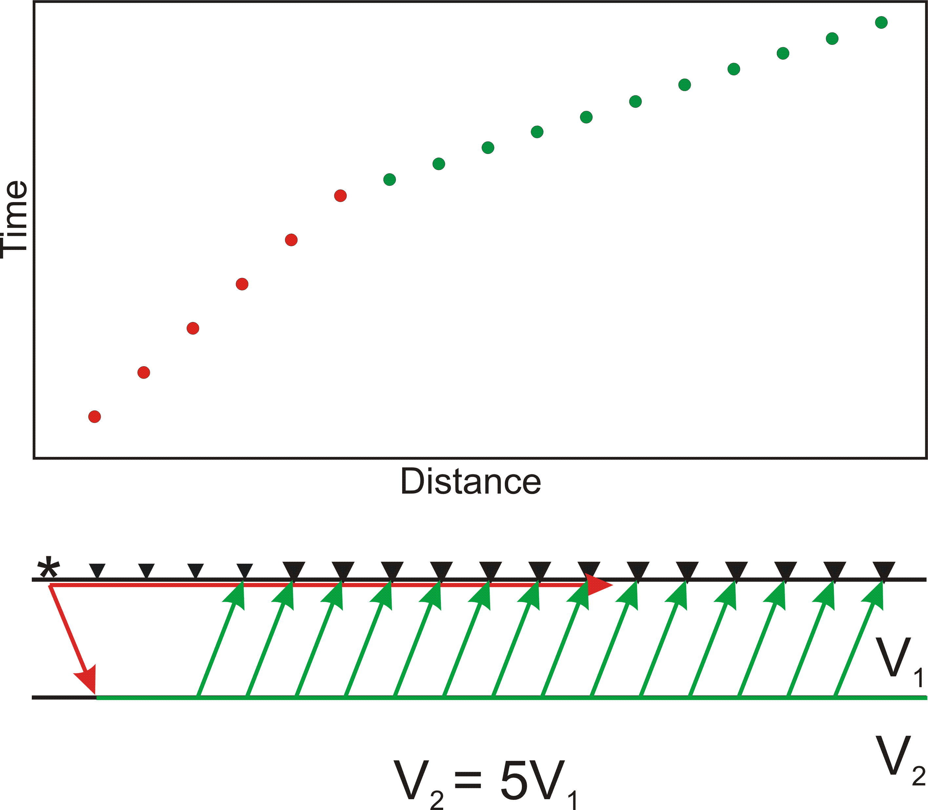
Using Seismic Refraction to Map the Subsurface

Slide 70
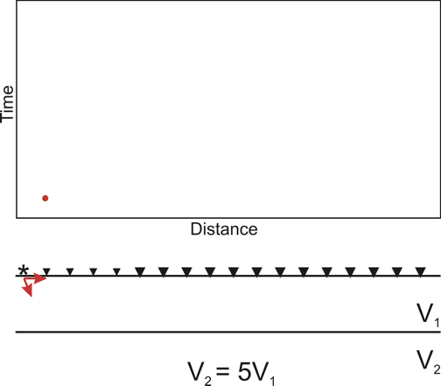
Using Seismic Refraction to Map the Subsurface

Slide 71
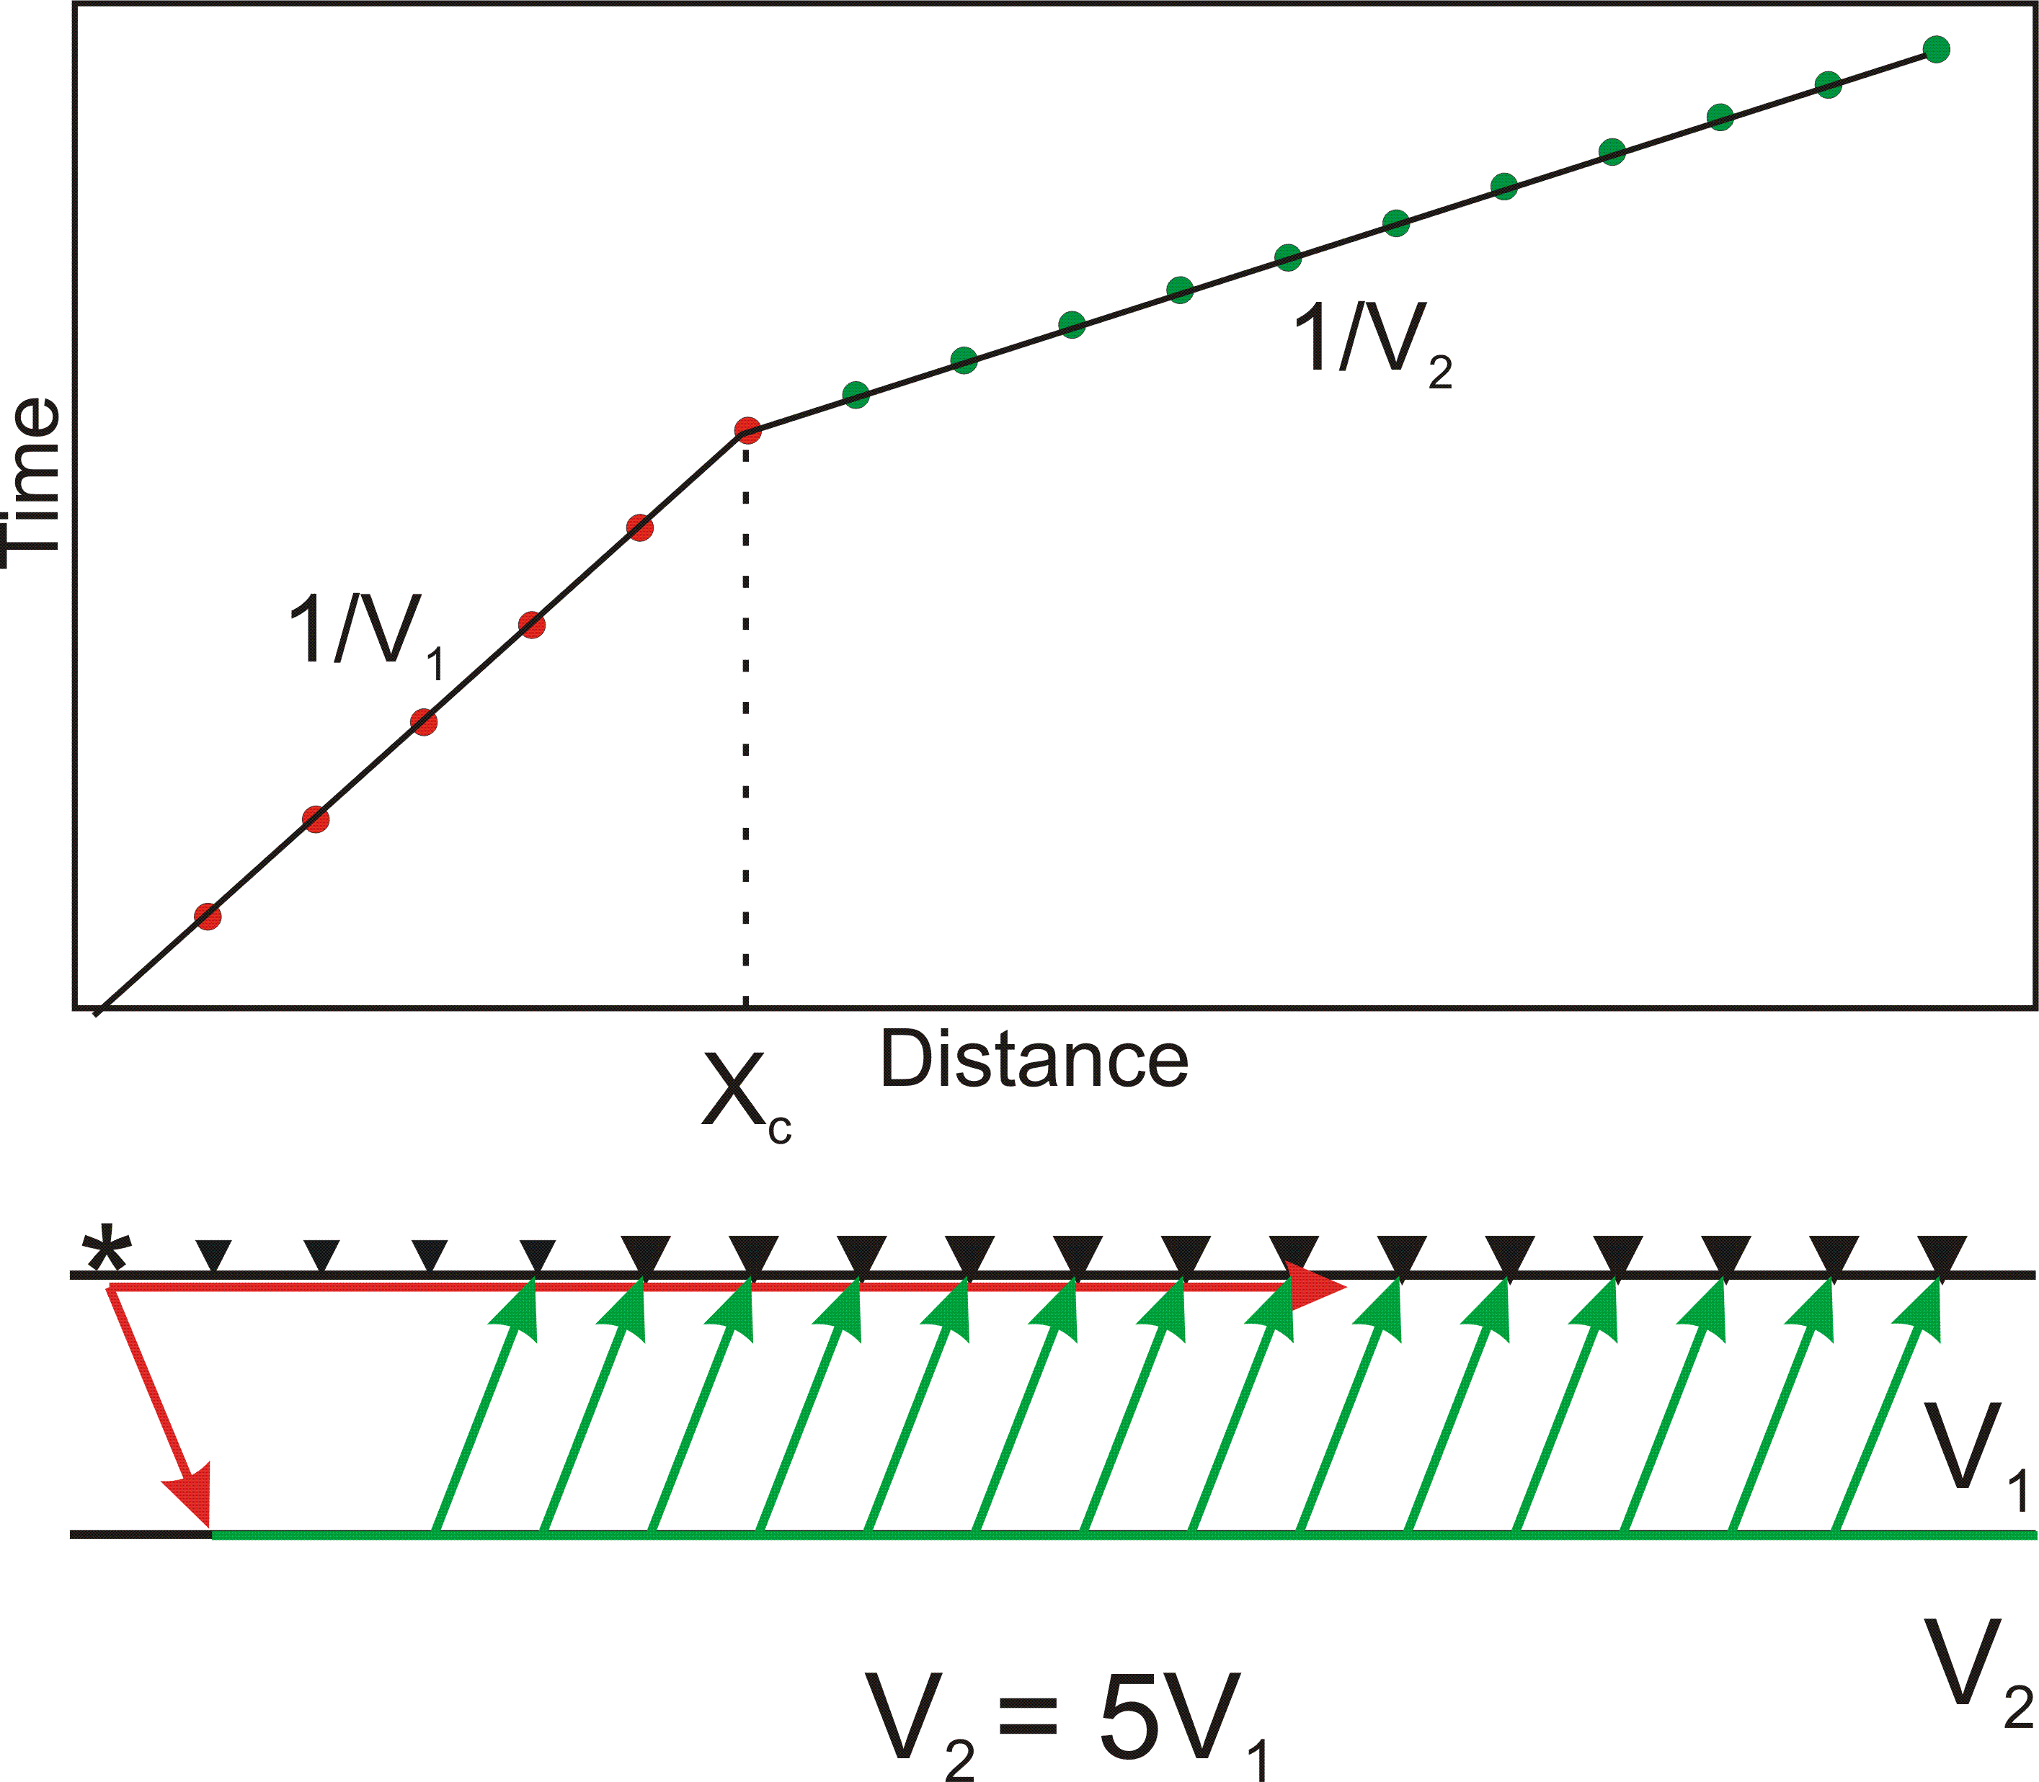
Using Seismic Refraction to Map the Subsurface
(5)
Depth{

Slide 72
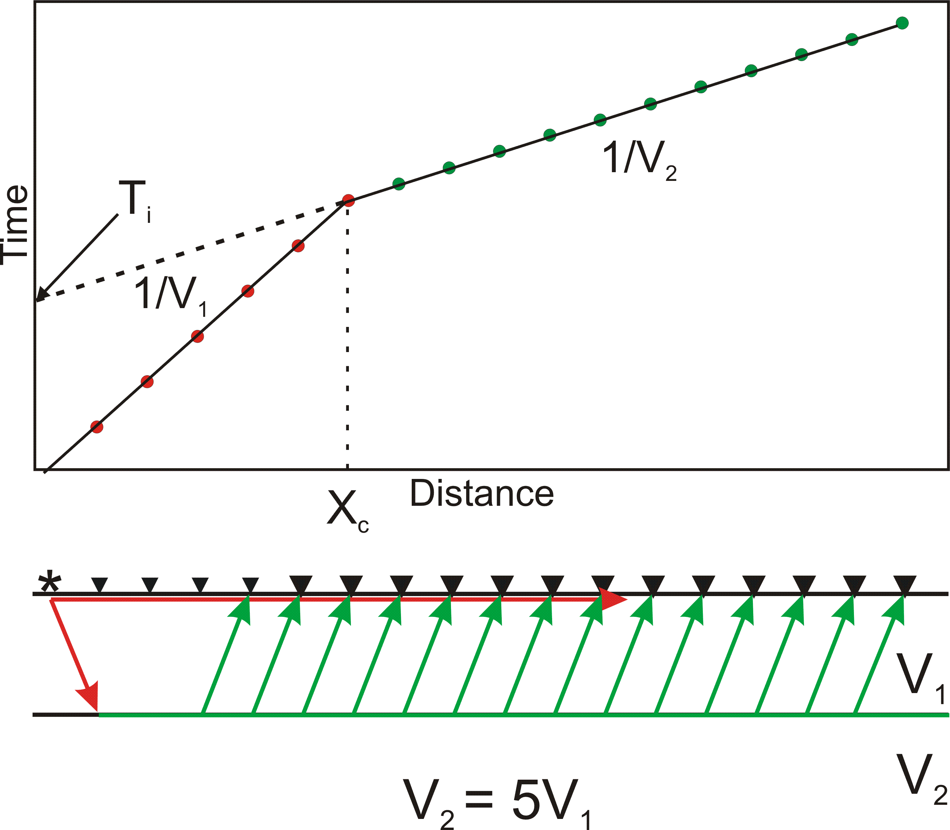
Using Seismic Refraction to Map the Subsurface
(6)
For layer parallel to
surface
Depth{

Slide 73
Summary of Important Equations
For refractor parallel to surface
(1)
Snell’s Law
(4)
(2)
(5)
(3)
(6)

Slide 74
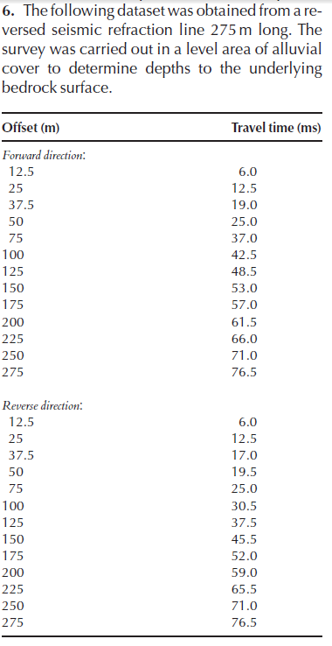

Slide 75
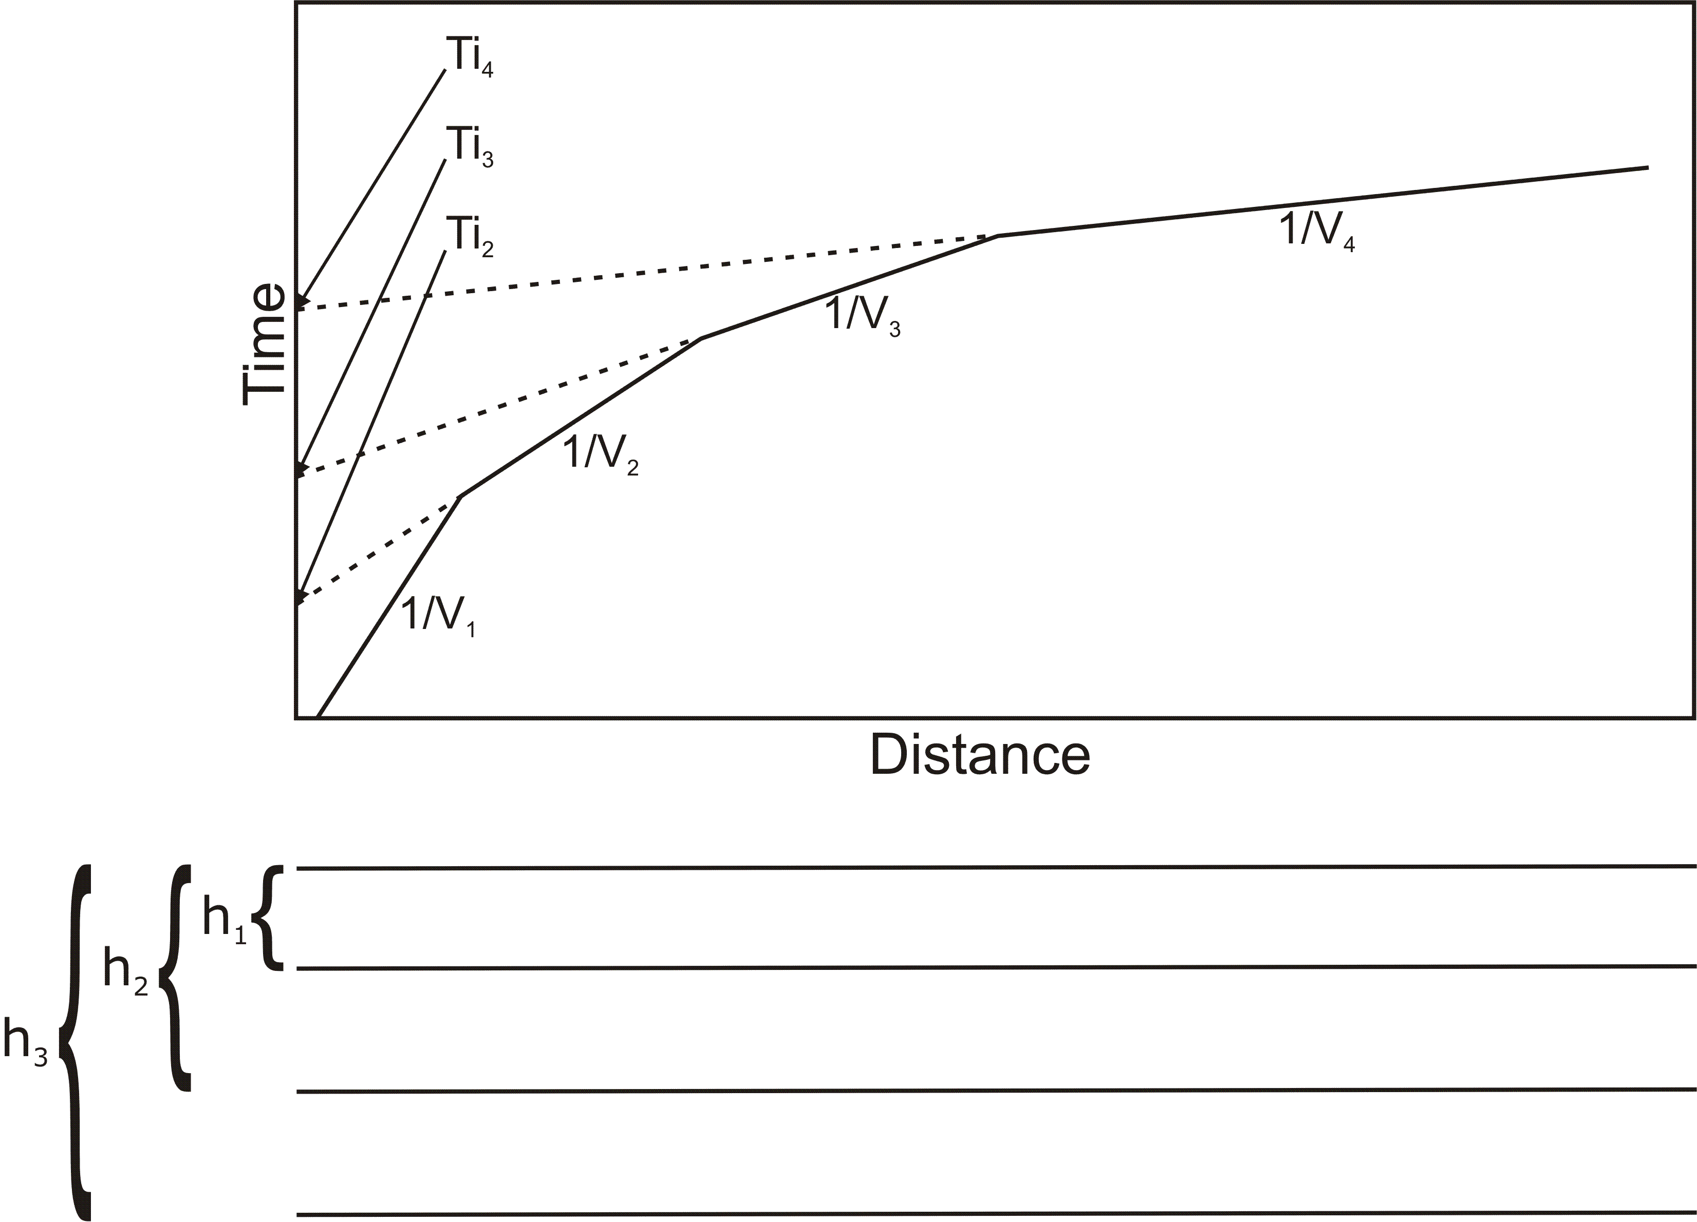

Slide 76
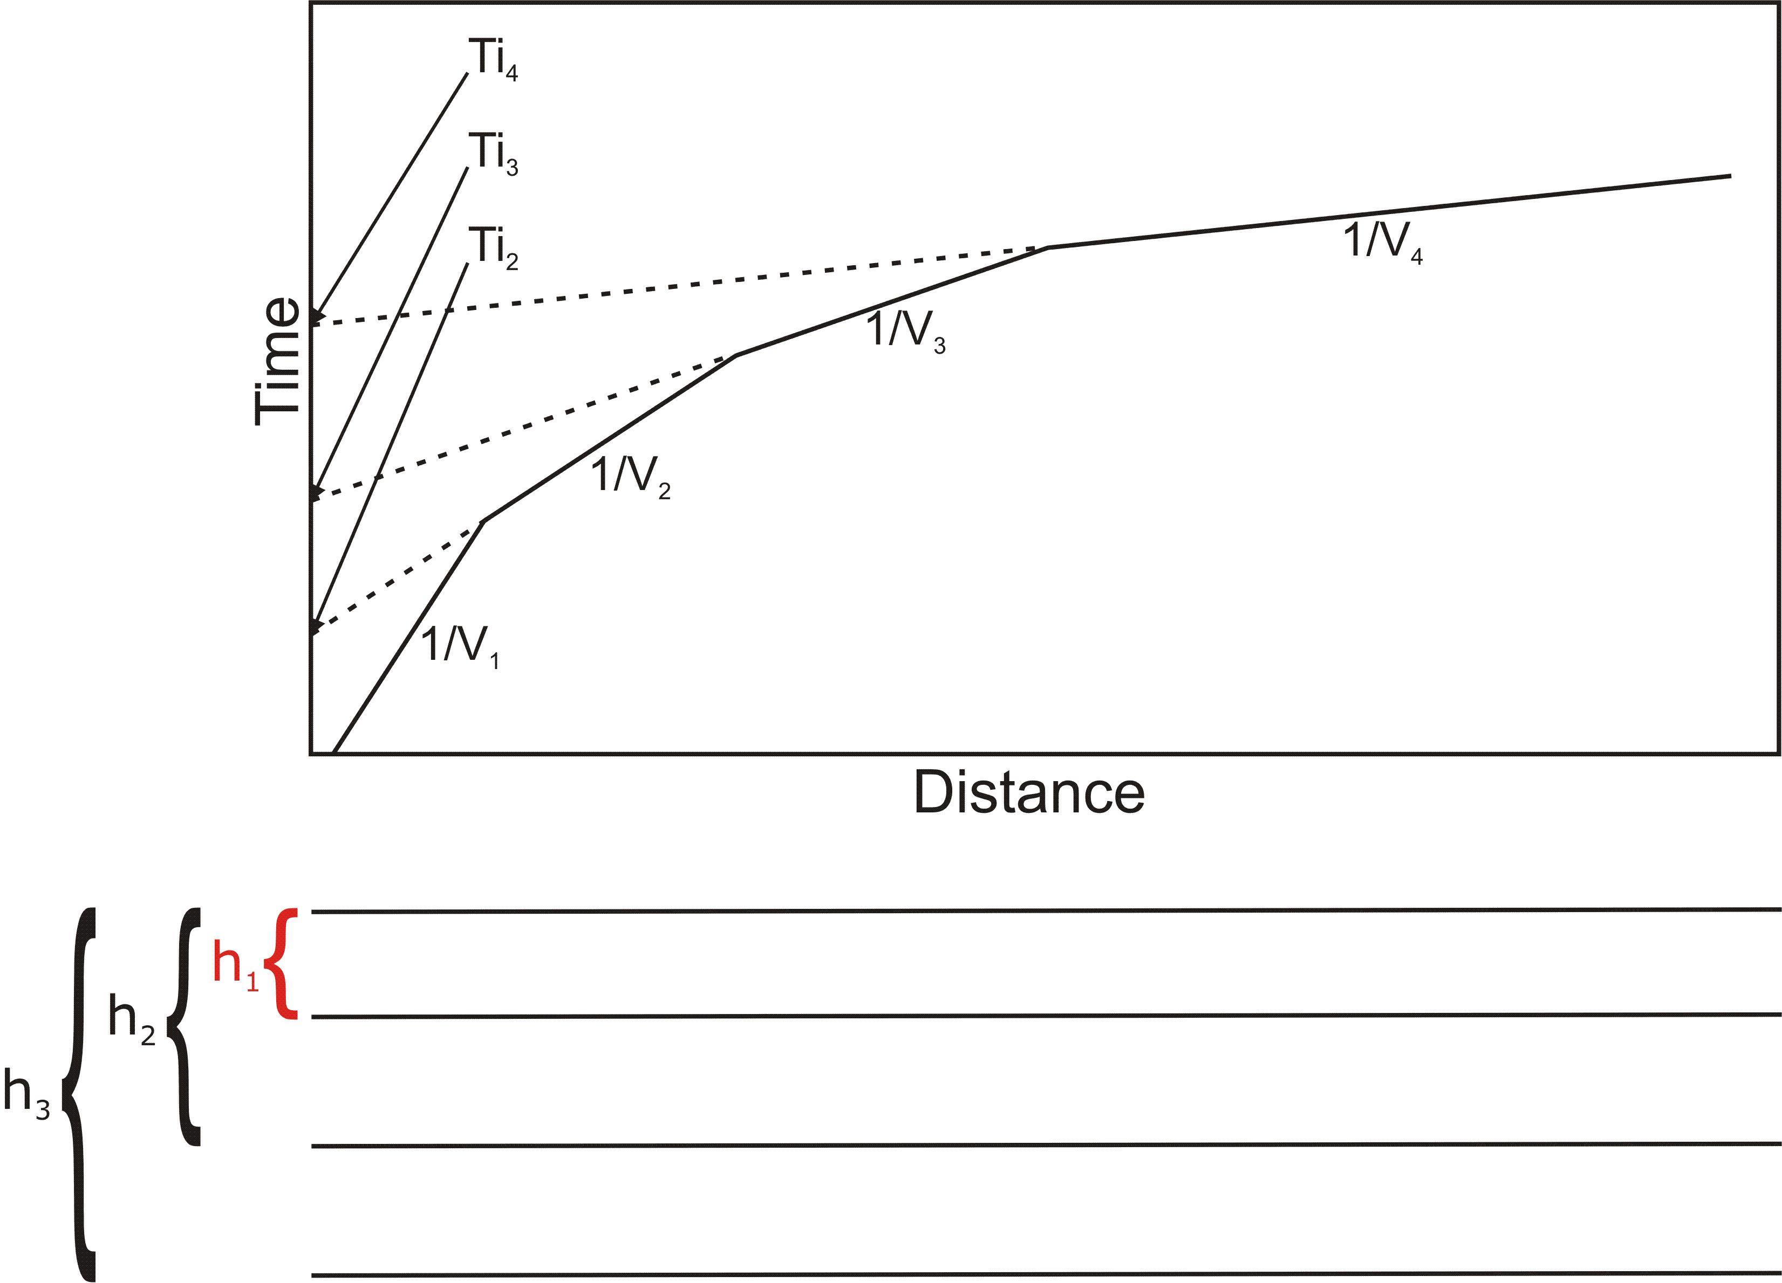

Slide 77
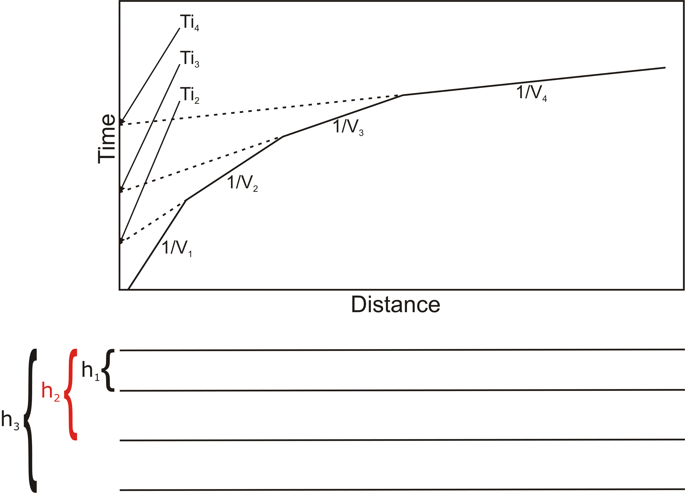

Slide 78
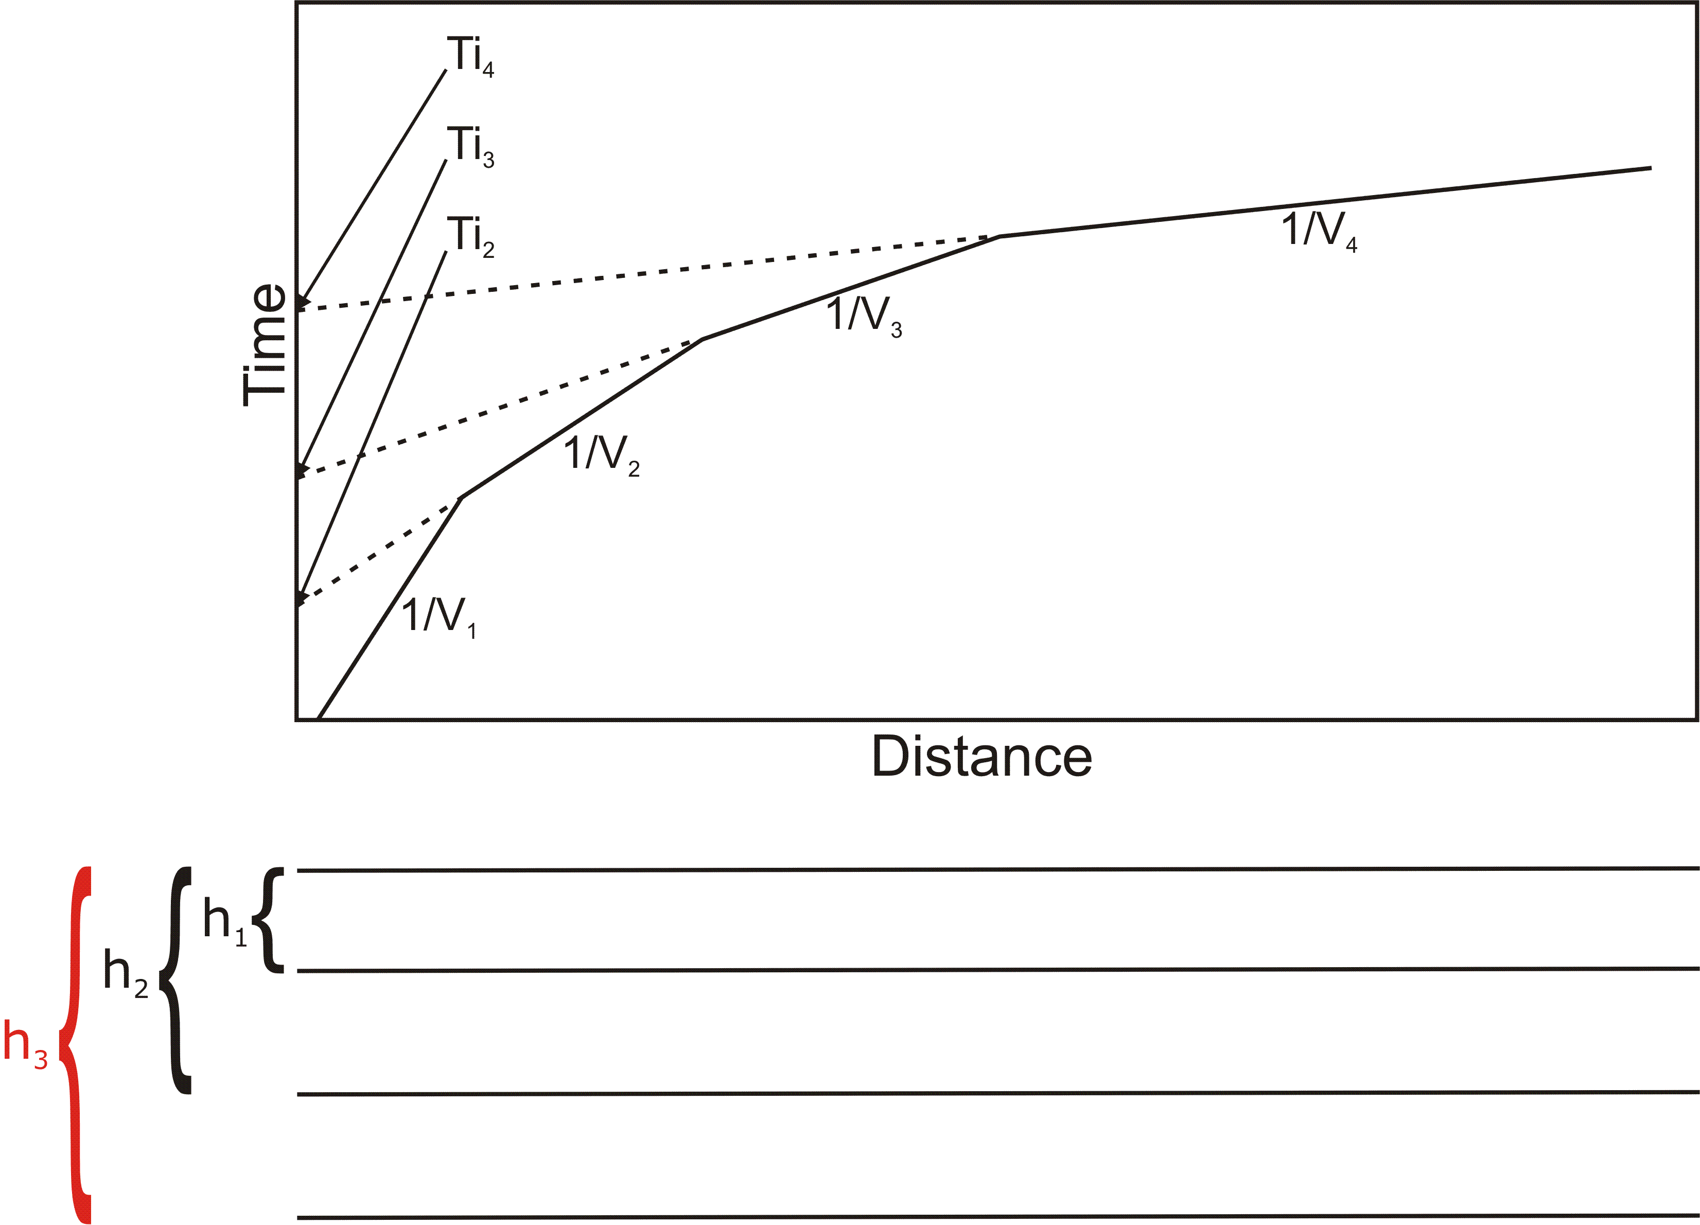

Slide 79

Crossover Distance vs. Depth

Slide 80

Depth/X_{c} vs. Velocity Contrast

Slide 81

Important Rule of Thumb
The Length of the Geophone Spread Should be 4-5 times the depth of interest.

Slide 82
Dipping Layer
Defined as Velocity Boundary
that is not Parallel to Ground Surface
You should always do a minimum of one shot at either end the spread. A single shot at one end does not tell you anything about dip, and if the layer(s) is dipping, your depth and velocity calculated from a single shot will be wrong.

Slide 83
Dipping Layer
If layer is dipping (relative to ground surface), opposing travel time curves will be asymmetrical.
Updip shot – apparent velocity > true velocity
Downdip shot – apparent velocity < true velocity

Slide 84

Dipping Layer

Slide 85
Dipping Layer

Slide 86
Dipping Layer
From Snell’s Law,

Slide 87
Dipping Layer
The true velocity V2 can also be calculated by multiplying the harmonic mean of the up-dip and down-dip velocities by the cosine of the dip.

Slide 88
What if V2 < V1?

Slide 89
What if V2 < V1?
Snell’s Law

Slide 90

What if V2 < V1?
Snell’s Law

Slide 91

What if V2 < V1?
If V₁>V₂, then as i increases, r increases, but not as fast.

Slide 92
If V2<V1, the energy refracts toward the normal.
None of the refracted energy makes it back to the surface.
This is called a velocity inversion.

Slide 93
Seismic Refraction requires that velocities increase with depth.
A slower layer beneath a faster layer will not be detected by seismic refraction.
The presence of a velocity inversion can lead to errors in depth calculations.

Slide 94



Slide 95


Slide 96


Slide 97



Slide 98



Slide 99


Slide 101
Delay Time Method
Allows Calculation of Depth Beneath Each Geophone
Requires refracted arrival at each geophone from opposite directions
Requires offset shots
Data redundancy is important

Slide 102

Delay Time Method
x
V₁
V₂

Slide 103

Delay Time Method
x
V₁
V₂

Slide 104

Delay Time Method
x
V₁
V₂

Slide 105

Delay Time Method
x
V₁
V₂

Slide 106
Delay Time Method
x
V₁
V₂
Definition:
(7)

Slide 108
But from figure above,
. Substituting, we get
or

Slide 109
Substituting from Snell’s Law,

Slide 110
Multiplying top and bottom by sin(i_{c})

Slide 111
Substituting from Snell’s Law,
We get
(8)

Slide 112
(9)

Slide 113

Reduced Traveltimes
x
Definition:
T’_{AP} = “Reduced Traveltime” at point P for a source at A
T’_{AP}=T_{AP’}
Reduced traveltimes are useful for determining V₂. A plot of T’ vs. x will be roughly linear, mostly unaffected by changes in layer thickness, and the slope will be 1/V₂.

Slide 114
Reduced Traveltimes
x
From the above figure, T’_{AP} is also equal to T_{AP} minus the Delay Time. From equation 9, we then get

Slide 115
Reduced Traveltimes
x
Earlier, we defined t_{o} as
(7)
Substituting, we get
(10)

Slide 116

Reduced Traveltimes
Finally, rearranging yields
(11)
The above equation allows a graphical determination of the T’ curve. T_{AB} is called the reciprocal time.

Slide 117

Reduced Traveltimes
The first term is represented by the dotted line below:

Slide 118

Reduced Traveltimes
The numerator of the second term is just the difference in the traveltimes from points A to P and B to P.

Slide 119

Reduced Traveltimes
Important: The second term only applies to refracted arrivals. It does not apply outside the zone of “overlap”, shown in yellow below.

Slide 120

Reduced Traveltimes
The T’ (reduced traveltime) curve can now be determined graphically by adding (T_{AP}-T_{BP})/2 (second term from equation 9) to the T_{AB}/2 line (first term from equation 9). The slope of the T’ curve is 1/V₂.

Slide 121
We can now calculate the delay time at point P. From Equation 10, we see that
(10)
According to equation 8
(8)
So
(12)
Now, referring back to equation 4
(4)

Slide 122
It’s fair to say that
(13)
Combining equations 12 and 13, we get
Or
(14)

Slide 123
Referring back to equation 9, we see that
(9)
Substituting into equation 14, we get
Or
(15)
Solving equation 9 for h_{p}, we get
(16)

Slide 124
We know that the incident angle i is critical when r is 90º. From Snell’s Law,

Slide 125
Substituting back into equation 16,
(16)
we get
(17)

Slide 126

In summary, to determine the depth to the refractor h at any given point p:

Slide 127

1.Measure V₁ directly from the traveltime plot.

Slide 128

2.Measure the difference in traveltime to point P from opposing shots (in zone of overlap only).

Slide 129

3.Measure the reciprocal time T_{AB}.

Slide 130

,
4. Per equation 11,
divide the reciprocal time T_{AB} by 2.

Slide 131

,
5. Per equation 11,
add ½ the difference time at each point P to T_{AB}/2 to get the reduced traveltime at P, T’_{AP}.

Slide 132

6. Fit a line to the reduced traveltimes, compute V₂ from slope.

Slide 133
7. Using equation 15,
(15)
Calculate the Delay Time D_{T} at P₁, P₂, P₃….P_{N}

Slide 134
8. Using equation 17,
(16)
Calculate the Depth h at P₁, P₂, P₃….P_{N}

Slide 135
That’s all there is to it!

Slide 136



Slide 137


Slide 138


Slide 139


Slide 140


Slide 141


Slide 143


Slide 144


Slide 145


Slide 147

More Data is Better Than Less

Slide 148

More Data is Better Than Less

Slide 149

More Data is Better Than Less

Slide 150

More Data is Better Than Less

Slide 151

More Data is Better Than Less

Slide 152

More Data is Better Than Less

Slide 153

More Data is Better Than Less

Slide 154

More Data is Better Than Less

Slide 155

More Data is Better Than Less

Slide 156

More Data is Better Than Less

Slide 157


